Slide 1



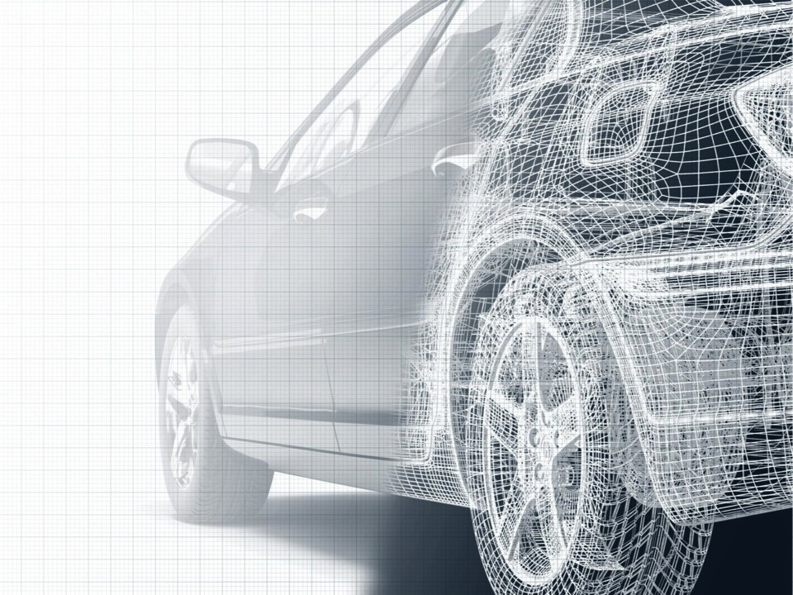


Gothenburg CLP mAutomotive workshop
10 mega trends for the connected car
Supported by
24th October 2012
David McClure
All rights reserved ©Secured by Design Ltd.
Reproduction in whole or in part is strictly prohibited

Slide 2

Europe
Services |  | Audi | BMW | Fiat | Ford | JLR | Mazda | Mercedes-Benz | Mini | Nissan | Opel | PSA | Renault | Smart | Toyota | Volvo | VW
Safety | eCall |  |  |  |  |  |  |  |  |  |  |  |  |  |  | 
 | bCall |  |  |  |  |  |  |  |  |  |  |  |  |  |  | 
 | Crisis assist
Security | Stolen vehicle services |  |  |  |  |  |  |  |  |  |  |  |  |  |  | 
 | Remote door lock/ unlock |  |  |  |  |  |  |  |  |  |  |  |  |  |  | 
 | Personal security alert
Maintenance | Remote diagnostics |  |  |  |  |  |  |  |  |  |  |  |  |  |  | 
 | Maintenance alert/ support |  |  |  |  |  |  |  |  |  |  | 
Navigation | Route operator assistance |  | 
 | Destination / route send-to-car |  |  |  |  |  |  |  |  |  |  |  |  |  |  |  | 
 | Off-board/ Smartphone navigation |  |  |  |  |  |  | Planned |  |  |  |  |  | 
 | Vehicle finder
 | Traffic information |  |  |  |  |  |  |  |  |  |  |  |  | 
 | Speed camera information |  |  |  |  |  |  |  |  |  |  |  | 
 | Parking space information |  |  |  |  |  |  |  |  |  |  |  |  |  | 
 | Weather information |  |  |  |  |  |  |  |  |  |  |  |  |  |  |  | 
 | Fuel price information |  |  |  |  |  |  |  |  |  |  | 
 | In-car local search |  |  |  |  |  |  |  |  | Planned |  |  |  |  |  |  | 
 | Specific business listings |  |  |  |  |  |  |  |  |  |  | 
 | Travel guides |  |  |  |  |  |  |  |  |  |  | 
 | Satellite imagery |  |  |  |  |  |  |  |  |  |  |  |  |  |  |  | 
 | Photo imagery |  | 
 | Location sharing |  |  |  |  |  |  | 
 | Last mile guidance |  |  |  |  |  |  |  |  |  |  |  |  |  | 
Driving style | Eco drive |  |  |  |  |  |  |  |  |  |  |  | Planned |  | 
 | Fun drive |  |  |  |  |  |  |  |  |  | 
Infotainment | News/ stocks/ sports |  |  |  |  |  |  |  |  |  |  |  |  |  |  |  | 
 | Events
 | Office/ communication tool |  |  |  | Planned |  |  |  |  |  |  |  |  |  | 
 | Unlimited internet access |  |  |  | Planned |  |  | 
 | User reviews |  |  |  |  |  |  |  |  |  |  | 
 | LBS listings |  | 
 | Concierge services
 | Web-based entertainment |  |  |  | Planned |  |  |  |  |  | Planned |  |  |  | 
 | Social networking |  |  |  | Planned | Planned |  |  |  |  |  |  |  |  |  |  | 
Convenience | Remote control/ monitoring |  |  |  |  |  |  |  |  |  |  |  |  |  |  | 
Insurance | PAYD/ PHYD
EV specific | Charging information |  |  |  |  |  |  |  |  |  | Planned |  | Planned | 
 | Remote control/ monitoring |  |  |  |  |  |  |  |  |  | Planned |  | Planned | 
Urban mobility | Car pooling information
Commercial | Fleet management |  |  |  |  |  |  |  |  |  |  | 
Embedded
Tethered
S/phone
Integrated
PND

Slide 3


North America
Services |  | Acura | Audi | BMW | Chrysler | Ford | GM | Honda | Hyundai | Infiniti | Jaguar | Kia | Lexus | Mercedes- Benz | MINI | Nissan | Smart | Toyota
Safety | eCall |  |  | P | P | P | P |  | P | P |  | Planned | P | P |  |  |  | P
 | bCall |  |  | P | P |  | P |  | P | P |  | Planned | P | P |  |  | P | P
 | Crisis assist |  |  |  |  |  | P |  | P | P
Security | Stolen vehicle services | Planned |  | P |  |  | P |  | P | P |  |  | P | P |  |  |  | P
 | Remote door lock/ unlock | Planned |  | P | P |  | P |  | P | P |  |  |  | P
 | Personal security alert |  |  |  |  |  |  |  | P | P |  | Planned |  | P
Maintenance | Remote diagnostics | P |  | P |  | P | P |  | P |  |  | Planned |  | P
 | Maintenance alert/ support | Planned |  |  | P | P | P |  | P | P |  | Planned | P | P
Navigation | Route operator assistance |  |  | P |  |  | P |  |  | P |  |  |  | P
 | Destination / route send-to-car |  | P | P |  | P | P |  |  | P |  | Planned | P | P |  | P
 | Off-board navigation |  |  |  | P | P | P |  | P |  | Planned
 | Vehicle finder |  |  |  |  |  |  |  |  |  |  | Planned |  | P
 | Traffic information | Planned |  | P | P |  | P |  | P |  |  |  |  | P | P | P | P | P
 | Speed camera information
 | Parking space information
 | Weather information |  | P | P |  | P | P |  | P |  |  |  |  | P |  | P |  | P
 | Fuel price information |  | P | P | P |  | P |  | P
 | In-car local search | Planned | P | P |  |  |  |  | P |  |  |  | P | P | P | P | P | P
 | Specific business listings |  |  | P |  |  | P |  | P
 | Travel guides |  | P | P
 | Satellite imagery |  | P
 | Photo imagery |  |  |  |  |  |  |  |  |  |  |  |  | P
 | Location sharing |  |  |  |  |  |  |  | P
 | Last mile guidance |  |  | P
Driving style | Eco drive |  |  |  |  | P |  |  | P |  |  |  |  |  | P | P
 | Fun drive |  |  | P
Infotainment | News/ stocks/ sports | P | P | P |  | P | P |  |  |  |  |  |  | P
 | Events |  |  |  |  |  |  |  |  |  |  |  | P |  |  |  |  | P
 | Office/ communication tool | Planned |  | P | P |  |  | Planned | P | P |  |  |  |  |  | P
 | Unlimited internet access
 | User reviews |  |  |  |  |  |  |  | P |  |  |  | P | P |  |  |  | P
 | LBS listings
 | Concierge services | Planned |  |  |  |  |  |  |  |  |  |  |  | P
 | Web-based entertainment | Planned | Planned | P |  | P | P | P | P |  | Planned |  | P |  | P | P | P | P
 | Social networking |  | P | P |  | P | P |  |  |  |  |  | P | P | P
Convenience | Remote control/ monitoring |  |  |  | P |  | P |  | P |  |  |  |  | P
Insurance | PAYD/ PHYD |  |  |  |  |  | P
EV specific | Charging information |  |  | Planned |  | P | P | P |  |  |  |  |  |  |  | P | P
 | Remote control/ monitoring |  |  | Planned |  | P | P | P |  |  |  |  |  |  |  | P
Urban mobility | Car pooling information |  |  |  |  |  | 
Commercial | Fleet management |  |  |  |  |  | Planned
Embedded
Tethered
S/phone

Slide 4

China
Services |  | BMW | BYD | Chang’an | Chery | Dongfeng Yulon | Faw | Ford | GAC Group | Geely | GM | Hawtai | Hyundai | Lexus/ Toyota | Mini | Nissan | SAIC | SGM
Safety | eCall | Planned | P | P |  | P | P | Planned | Planned | P | P |  | P | P |  | P
 | bCall | Planned |  |  | Planned | P | P |  |  | P | P |  | P | P |  | P
 | Crisis assist
Security | Stolen vehicle services |  | P | P |  | P | P |  |  | P | P |  | P | P |  | P
 | Remote door lock/ unlock | Planned | P |  |  |  |  |  |  |  | P
 | Personal security alert
Maintenance | Remote diagnostics |  |  |  |  |  | P |  |  |  | P | P | P | P |  | P
 | Maintenance alert/ support | Planned | P | P |  | P |  |  |  |  | P |  | P | P |  | P
Navigation | Route operator assistance |  | P | P | Planned | Planned |  |  | Planned | P | P | P | P | P |  | P | P | P
 | Destination/route send-to-car | Planned |  |  |  | Planned |  |  |  | P |  |  |  |  |  |  | P
 | Off-board navigation |  |  |  |  |  |  |  |  |  | P |  | P | P
 | Car finder
 | Traffic information | Planned | P | P | Planned | Planned | P | Planned | Planned | P |  | P | P | P |  | P | P | P
 | Speed camera information |  |  | P
 | Parking space information |  |  |  |  |  |  |  | Planned
 | Weather information |  | P | P | Planned |  | P |  | Planned | P |  | P |  | P |  | P | P | P
 | Fuel price information
 | In-car local search |  |  |  |  | Planned |  |  |  |  |  |  |  |  |  |  | P
 | Specific business listings
 | Travel guides
 | Satellite imagery |  |  |  |  |  |  |  |  |  |  |  |  | P
 | Photo imagery
 | Location sharing |  | P
 | Last mile guidance
Driving style | Eco drive |  |  |  |  | Planned |  |  |  |  |  |  |  |  | P | P
 | Fun drive
Infotainment | News/ stocks/ sports |  | P | P | Planned | Planned | P | Planned | Planned | P |  |  |  | P | P | P | P | P
 | Events |  | P
 | Office/ communication tool | P |  | P | Planned | Planned | Planned |  | Planned | P |  | P |  | P |  |  | P
 | Unlimited internet access |  |  | P | Planned |  | P |  | Planned | P |  | P |  |  |  |  | P
 | User reviews
 | LBS listings
 | Concierge services |  |  | P
 | Web-based entertainment | P |  | P | Planned |  | Planned | P |  | P |  | P
 | Social networking | P |  |  |  | Planned | Planned | Planned |  |  |  |  |  |  | P |  | P
Convenience | Remote control/ monitoring | Planned | P | P | Planned |  |  |  |  |  | P |  | P
Insurance | PAYD/ PHYD
EV specific | Charging information |  | P |  | Planned
 | Remote control/ monitoring |  | P |  | Planned
Urban mobility | Car pooling information
Commercial | Fleet management
Embedded
Tethered
S/phone

Slide 5

1. People will still be talking about killer apps…
The hunt goes on,
and it will get worse with LTE
Killer apps provide short term tactical benefits…
…but little long term differentiation

Slide 6

2. Legislation will happen – start planning now
EU…2015?
RU…2015?
BR…2013?
Cars will be equipped with telematics boxes and SIMs…
…but most OEMs still don’t know what to do with them

Slide 7
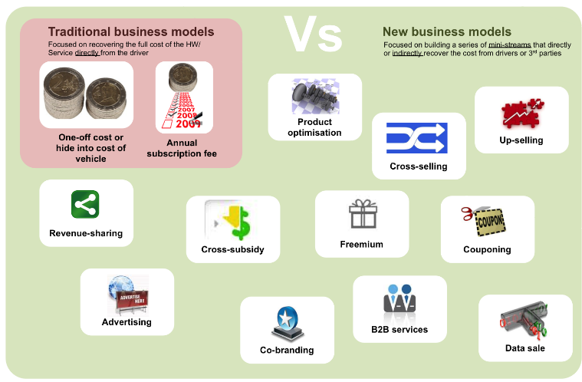
3. New business models are coming
The pricing revolution will start soon
Current business models lack sophistication…
…OEMs need help to develop more imaginative solutions

Slide 8
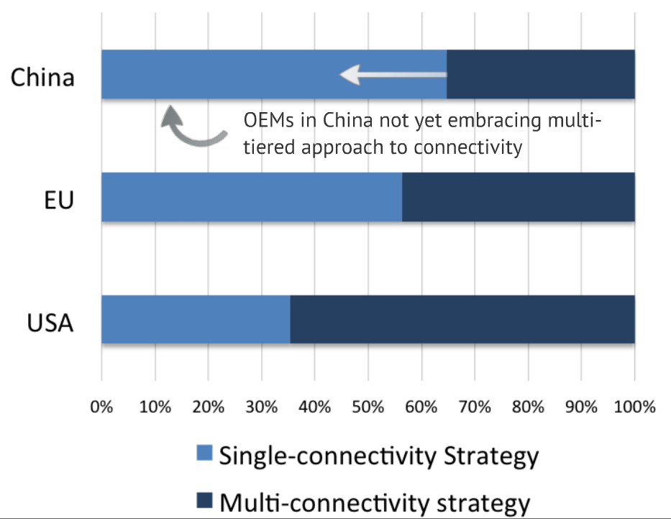
4. Connectivity will take many forms
One size doesn’t fit all
Embedded is great for many applications…
…but tethering and smartphone integration have a role

Slide 9
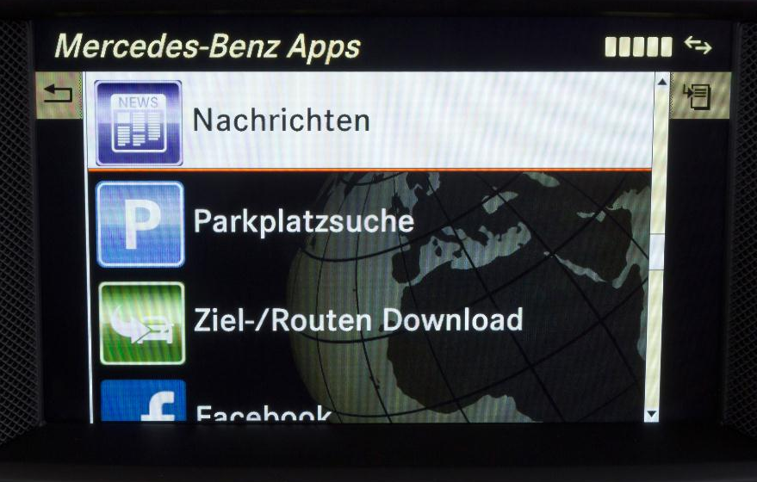
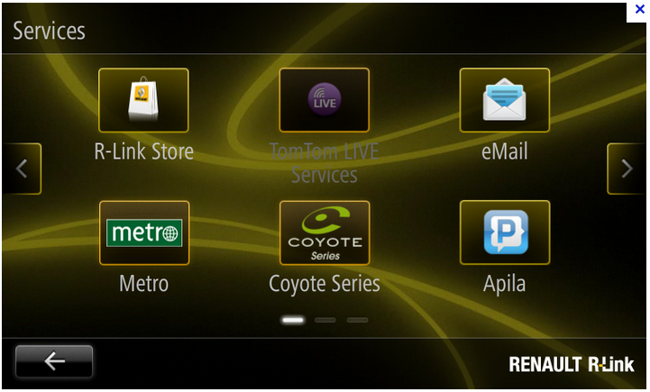
5. Customers will expect to personalise their services
App stores are creating a new level of expectation
Mercedes = 2 apps
Renault = 12-50 apps
Moving from fixed bundles to flexible apps…
…but how many can an OEM really offer?

Slide 10

6. Sun-setting will happen – start planning now
2G and even 3G won’t be here forever
OEMs need to develop future-proofing solutions…
…but what can MNOs do to make their lives easier?

Slide 11

7. SE Asia will become the next emerging market hotspot
Japanese OEMs are already shifting their attention away from BRICs
Huge markets with increasing disposable income…
…but as always, don’t get carried away by the hype!

Slide 12





8. No one fully understands the impact of GAMAF
How much control do they want to have in the car?
OEMs doing their best to stay close to the CE giants…
…but what is their end game in the connected car?

Slide 13
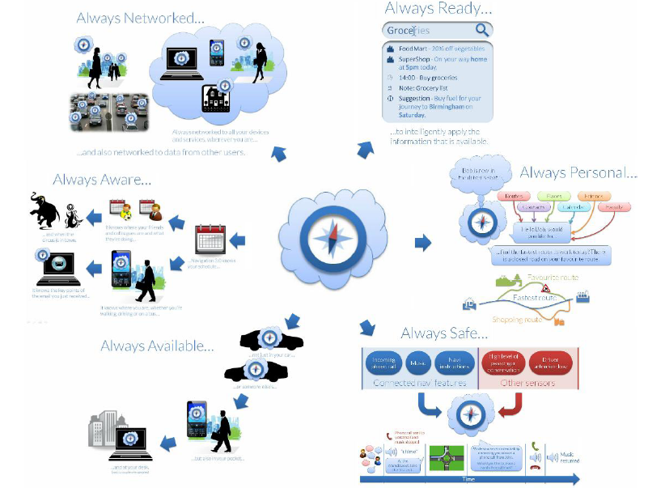
9. The connected car will start to think
The car will anticipate needs and learn preferences
The car can learn a lot about the driver…
…and it can share this knowledge with the outside world

Slide 14


10. The swan principle should be our ultimate goal
Things should just work for the customer
We need to deal with and hide the complexities
Connected services should work out of the box…
…the GSMA CCF has a big role in making this a reality

