Slide 1

Trends within in-vehicle connected services
Jan Unander
Executive Director
Where Telematics Professionals Meet

Slide 2
What
Non-profit organisation with only members interest in focus
Established in 2001
Cluster of companies and organisations with related businesses/ interests where Telematics is a vital part of their product or service
36 members ( 1,200 individuals)
Full value chain for creating any Telematics Solution
European companies are members
Core and base Gothenburg, Sweden
Not a Science Park running technical projects
Focus on development of business for members

Slide 3
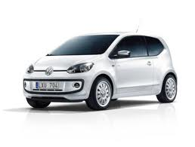
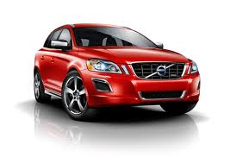
Trend for
Car Manufacturers?

Slide 4
Cars
Why pay for services?
Killer application
area
Frequency of use
Hands free
telephony
Navigation
Ecall
Perceived value
© Unander Information & Communication AB

Slide 5
New services in vehicles?
Killer application
area
Frequency of use
Social
control
“Relations”
Music
Spotify
eMail
Hands free
telephony
SMS
Messaging
Facebook
Navigation
Ecall
Perceived value
© Unander Information & Communication AB

Slide 6
New services in vehicles?
Killer application
area
Frequency of use
Social
control
“Relations”
Music
Spotify
eMail
Hands free
telephony
SMS
Messaging
Facebook
Navigation
Ecall
Perceived value
© Unander Information & Communication AB

Slide 7
Other services in vehicles?
Frequency of use
Music
eMail
Hands free
telephony
SMS
Messaging
Facebook
Book a service
Status of my car
Dealer offers
Navigation
B-Call
Lock/unlock
Honk the horn
Ecall
Perceived value
© Unander Information & Communication AB

Slide 8
Telematics service areas
Frequency of use
Customer driven
Infotainment
Relation services
External players
make the revenues
Qualifyers
Brand Loyalty
Spares
Accessories
Labour
Safety
Security
Functions
Find my way
Car Manufacturers
Core business
Difficult to charge
for or small volume
Winner/ Qualifyer
Perceived value
Vehicle/Dealer/ OEM
Centric
© Unander Information & Communication AB

Slide 9
Conclusions
No strong CAR OEM business case on infotainment
Low frequency services or functions free of charge – Qualifiers to sell cars
Advertising and service bookings is an internal marketing tool - cannot charge customer
So Why?

Slide 10
Trend - Cars
Support the Car Manufacturers
CORE BUSINESS.
.
70% of profit comes from the aftermarket business
Place out cars on the market
(low profit)
Sell spares, accessories and work shop man hours
(high profit)
All decisions should strenghthen
the core business

Slide 11
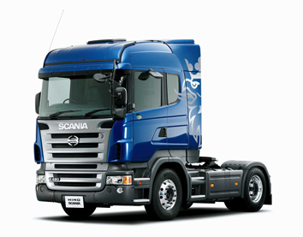
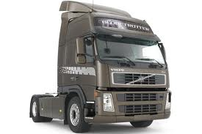
Trend for
Commercial Vehicle manufacturers?

Slide 12
Trucks
Prerequisites
Professional tool
Node in an information ECO- system
Objective is to deliver goods
  Right place
  Right time
  Undamaged
To lowest cost for all parties involved
Polluting less
Still give some profit for the truck/fleet owner
INFORMATION IS KEY TO ACCOMPLISH
ALL THIS

Slide 13
Market drivers
Low margins (0-3%) in the transport business
High demands on information exchange to cut cost in transportation of goods
Haulers want smart driving to cut operational cost
Logistic companies require FMS from Fleet Owners
Large number of more or less proprietary FMS solutions on the market
Only 12-13% market penetration of FMS
Truck Manufacturers line fit Telematics units in ”all” trucks
The FMS market is in for a dramatic change that will
influence the whole industry.

Slide 14
Services composition per segment
Illustrative
OEM / dealer
workshops
Finance / insurance
companies
Vehicle/fleet operator
Goods / people owner/forwarder
Driver / passengers
Authorities /
road operators
Dynamic
Service Planning
Vehicle management
Vehicle management
Goods
tracking
Infotainment
(Internet)
Security/safety
services
Remote diagnostics
Security/safety
services
Driver time
management
CO2 reporting
Navigation &
traffic info.
Traffic
management
Remote SW updates
Pay-as-you-drive
solutions
Security/safety
services
Transport
management
Driver security
(e-call)
Breakdown
services
Traffic, transport
management
Vehicle management
Messaging /
Social media
OEM services (vehicle centric)
Aftermarket services
Courtesy of Volvo Group Telematics

Slide 15
Connected Service Quadrants
The service values
Revenue
(image)
Customer/Driver
OEM/Dealer
4
Transport efficiency & convenience
Non-vehicle centric
(ex. Navigation, logistics, POI ..)
1
Increased Aftermarket /Service Sales
Increased Vehicle Sales
(ex. Parts, finance, insurance…)
Transport
Operation/
Driver
centric
3
Vehicle Management Efficiency
Vehicle centric
(ex. Fuel costs, energy, safety…)
2
Quality and risk management
(ex. Warranty, Service
contracts , lead-time reduction…)
Vehicle/dealer/OEM
centric
Cost Savings
Courtesy of Volvo Group Telematics

Slide 16
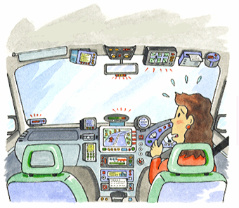
Collaboration and integration is a key issue!
If it fails, it might look like this...
GOOD FOR MOBILE NETWORK OPERATORS?
*
NOT FOR THE TRANSPORTATION INDUSTRY!

Slide 17
Can we establish a common solution with strong industry support?
Shared
Open Solution
Reference architecture with clear interfaces
Developer community / Program
Ownership, Business models /revenue sharing
Strong
Vehicle OEM, telematics industry support
SDK, Training, support ,
user groups etc.

Slide 18
Conclusions
FMS Standardisation opens up for more and better data sharing
Line fitted telematics will hurt FMS suppliers business on embedded solutions
FMS market penetration low – potential high
Most actors in the Transport ECO-system will benefit from more openness
Vehicle Manufacturers will climb higher on the service ladder
3:rd party FMS suppliers must create even more value to logistic companies to compete
New business models will be created

Slide 19
Trend - Trucks
Support the Truck Manufacturers
CORE BUSINESS.
70% of profit comes from the aftermarket business
Place out cars on the market
(low profit)
Sell spares, accessories and work shop man hours
(high profit)
AND REDUCE COST IN
- Contracts
- Warranty
- Workshop efficiency
All decisions should strenghthen
the core business

Slide 20

Mobile Network Operators

Slide 21
A changing marketplace
(October 11, 2012)Two of the world's largest telecoms groups,Telenor and Telefónica, have teamed up to make Telenor APIs available on Telefónica's BlueVia platform, a shared API platform for building and marketing applications.
(October 16, 2012) “The Softbank/Sprint deal represents the second major transaction announced this month in the U.S. wireless market, following the agreement between T-Mobile and MetroPCS,”
(October 17, 2012 )Sprint in talks to take control of Clearwire without an acquisition
(October 18, 2012 )Verizon to Buy Hughes Telematics for $612 Million
(October 22, 2012 )Verizon Wireless and Time Warner Cable Inc. (NYSE: TWC) today announced they are teaming up in Corpus Christi to offer new and existing customers greater choice, value and convenience in their wireless and entertainment packages.
(October 22, 2012) MasterCard, T-Mobile, Orange partner in Poland

Slide 22
Reflections
Investments increase LTE, 4G to meet demand
Profit decreases from voice and connectivity
Voice now an application amongst many
New competitors
New technologies (cloud)
New sources of revenues
New business models
M2M Immature and fragmented market

Slide 23
MNO - Core business?
Communication data, text, images and voice.
Own the network - offered as a service.
The ”fleet owner” in communications.
In an evolution process all is Data/ IP.
Internet has created a ”free” lane.
Services, billing climb the service ladder.
When do you compete with your customers?
How high on the Service Ladder should you climb?

Slide 24
The service ladder?
$
Services
Competing with customer
All decisions should strenghthen
the Core business
Extreme competition
Applications
Platforms
incl.cloud
CORE?
Data
Complexity

Slide 25
Thank you!

