Slide 1


Vodafone Global Enterprise
Connecting Vehicles & Transport to the Cloud
GSMa mAutomotive Workshop
Oct 24th 2012
David Levine
Global Head of Automotive Business Development
Vodafone Global Enterprise

Slide 2
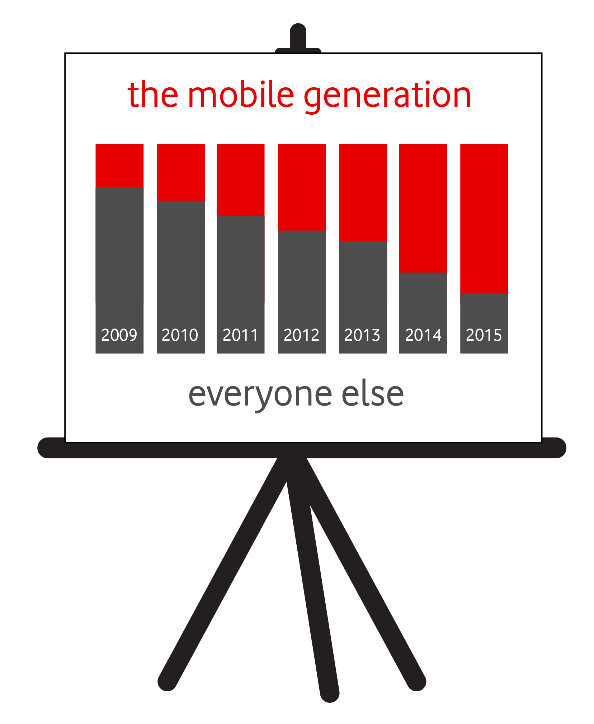
Mega trends in mobility
Desire for people to bring their personal cloud-based social interactions, data and applications into the car, thus requiring more cellular connectivity
Cars are no longer the only status symbol amongst young people, instead of owning car sharing becomes a trend
Increasing environmental awareness and urbanization in addition to the rapidly increasing cost of motoring (fuel and insurance), smarter and multi-modal ways of travelling (car, public transport, bike, plane, train) will become the norm

Slide 3


Why are operators interested?
100
million
Number of new vehicles sold every year
ONE
Billion
Total number of vehicles on the road today
$202
Billion
Potential revenues generated
by the automotive sector by 2020

Slide 4

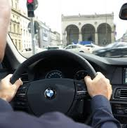


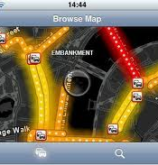


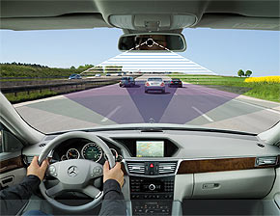

What do we mean by a connected vehicle?
Safety & Security
Infotainment
Vehicle
Diagnostics
Navigation
and Traffic
Usage Based Insurance (UBI)
Driver Assistance
Road Charging
Mobile Office

Slide 5

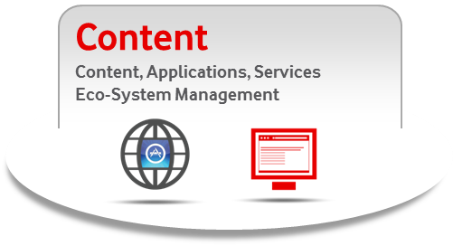
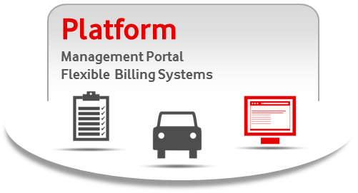





3 essential components of the connected vehicle
Mobile Network Operators have capabilities in all 3
A strong network creates rich product and service opportunities
A stable, flexible platform is essential for efficient development and future management of products and services
A world of innovation, partnership and opportunity for content developers and providers

Slide 6




Challenges in connecting vehicles to the cloud
Regulation
In Europe by 2015
Customers desire less complexity
and more integrated solutions
Consumer Devices
Roaming
Notes:
Ecall - Vehicle manufacturers will have to equip all newly Type Approved models with eCall from the end of 2014.
Ecall 2 –The Type Approval legislation is currently being prepared by the DG Enterprise within the EC and is expected to be released this summer with enforcement due at the end of 2014, Member States will be required by DG Move to upgrade their Public Safety Answering Points (PSAPs) and emergency services in parallel to the requirements on vehicle manufacturers. Mobile Network Operators (MNOs) will also be required by DG Infso to provide an eCall Flag that identifies the eCall as an emergency message from a vehicle.
Ecall 3- if a crash occurs and the eCall is not effective it will be the vehicle manufacturer that gets blamed by the consumer and the vehicle manufacturer needs to develop a strategy to respond to this.

Slide 7

Adding a SIM means even greater complexity
SIM Order
SIM order management
and logistics
Inactive Status
Installation
SIM is installed
in production line
Testing Status
Warehouse
Warehouse
Management
Ready Status
Recovery
End of Life.
Central
Management
Activation
SIM activation
Active Status
Termination
SIM is terminated
Terminated Status
Suspension
SIM is suspended in case
of issues or if it is lost
Suspended Status
Operation
Device and SIM
are operating
ActiveStatus
Operator’s activity
OEM’s activity

Slide 8
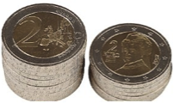

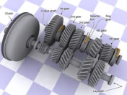











New business models
Traditional business models
Vs
New business models
Focused on recovering the full cost of the HW/Service directly from the driver
Focused on building a series of mini-streams that directly or indirectly recover the cost from drivers or 3rd parties
Product optimisation
One-off cost or hide into cost of vehicle
Annual subscription fee
Up-selling
Cross-selling
Revenue-sharing
Cross-subsidy
Freemium
Couponing
Advertising
B2B services
Data sale
Co-branding

Slide 9
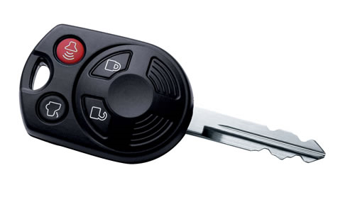
Achieving mobile connectivity
There are 3 ways for connecting the vehicle
Embedded
  Using the embedded SIM is relevant to car centric apps
  or cloud information
  Embedded gives the best performance for safety (e-call/b-call) and remote diagnostics & control, (EV in future) and stolen vehicle tracking
Tethering
  Using the smartphone as modem is relevant to cloud information, or eventually to car apps but multiple issues (bluetooth, missing hassle free configuration,…)
Aftermarket Device (Dongle)
  Using OBD- II, it can deploy various car centric services
  Faster deployment to market

Slide 10


The Automotive Cloud is not just about storage…

Slide 11



Consumer Demands and Expecation
Connected Suitability
Embedded
Tethered
Mid/Low Value – Growing Market Interest
High Value – Growing
Market Interest
Weather, Stocks, Data, News
PAYD- User based Insurance
Eco- Driving
Workflow Management / Fleet
EV Charging and billing
Location based services
Road tolling
Internet Radio
Email
High Definition Traffic
Bandwidth Requirements
High Bandwidth –
High Cost
Low Value – Limited
Market Interest
Music Download
Basic Traffic
Remote Diagnostics
Video Download
Remote Door unlock / Heat
HD Video Download
eCall – Automatic Crash Notification
Source: Strategy Analytics May 2012
Stolen vehicle tracking

Slide 12






Enabling the connected vehicle
What an operator should be delivering
Global Partnerships, Content and Applications
Service Level
Agreements and Support
Real Automotive Experience
Footprint
Pricing

Slide 13
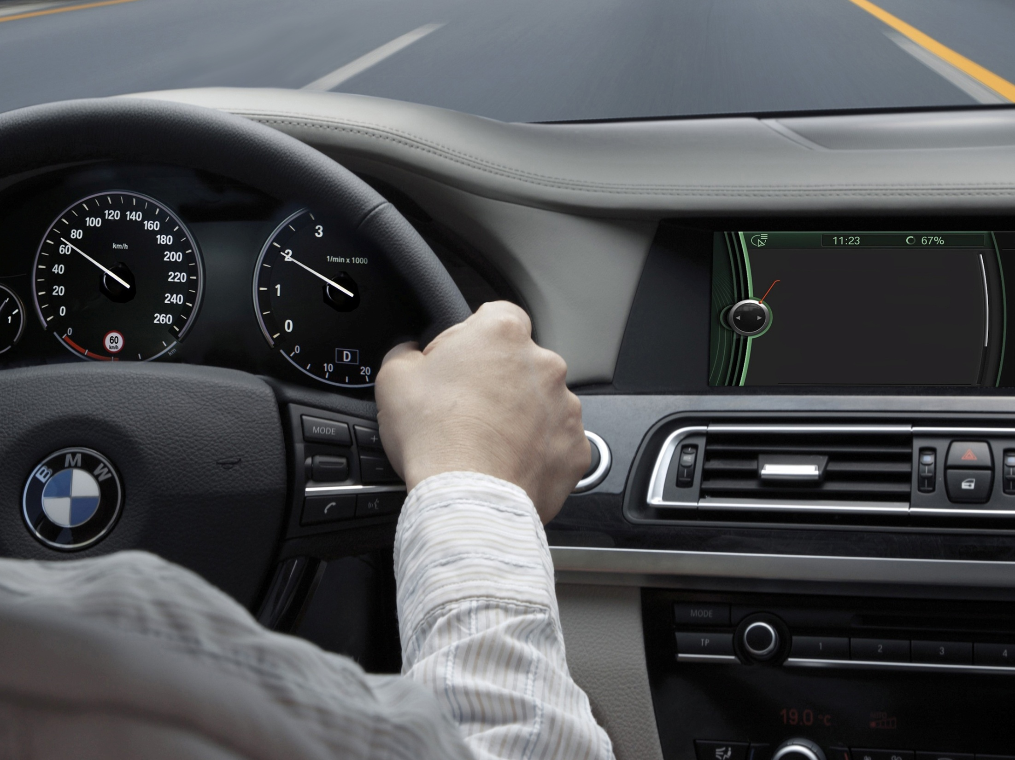

What’s next?

