Slide 1
WirelessCar
- a Telematics Service provider -
2012
magnus.johansson@wirelesscar.com

Slide 2

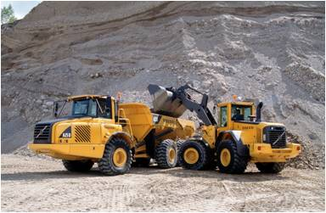
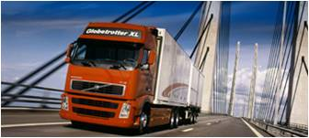
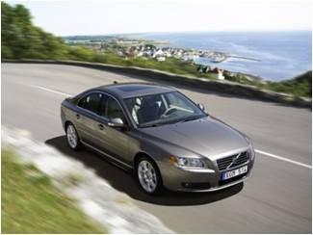


WirelessCar, an operator of connected services for the automotive industry
Founded 1999 as a JV between Ericsson, Telia and Volvo
100 % focus on telematics-enabled services
First telematics services delivered 2000
Volvo Cars, BMW, Audi, Chrysler, Volvo Trucks and Volvo Construction Equipment prime customers
Service delivery to ~ 1,5 Million vehicles in 50 countries, on 4 continents and in 2 business areas
Owned by Volvo Group through Volvo Information Technology AB

Slide 3







Customer References

Slide 4
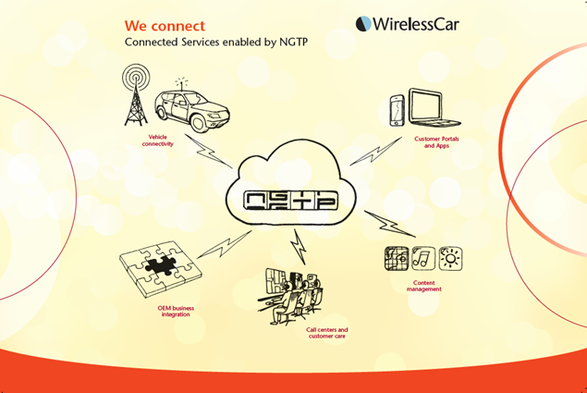

Slide 5
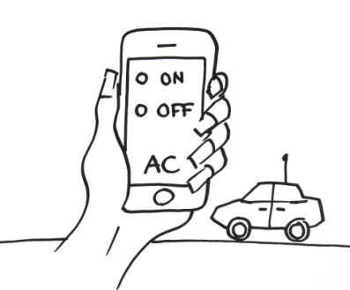

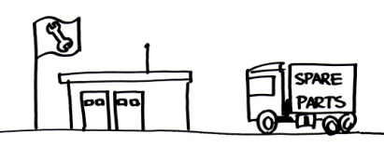
Today only 2% of the vehicles are connected!
Opportunities
OEM value
Customer appeal
Cost efficiency
OEM value
Increased aftersales
Loyal customers
Dynamic service planning
Second owner relationship
Software management
Logistics
Customer appeal
Cost efficiency
Developed by BMW, Connexis & WirelessCar
Flexible & scalable
Reduce cost through openness and standard
Avoid lock-in situation
De-mystify the eco-system of telematics
The analyst scenario
The reality scenario
Threats
Consumer electronics pricing
Internet is free!
Connected smart phones
The end-user scenario
2008
2015
How can we claim the remaining 98%?

Slide 6
Connected Car Challenge
How to assure access to attractive cloud services without jeopardizing automotive security requirements and rigid life cycle management processes

Slide 7
Dual channels to the vehicle ?
Car centric services, low bandwidth requirements, high safety and security requirements, global roaming agreements, long service life cycles, predictable cost, subscription owned and controlled by the OEM, provided as part of the car
Driver centric services, with high bandwidth requirements, short service lifecycles, personalized services, smart phone based, customer owned subscription

Slide 8
Telecom + Automotive = True ?
Different viewpoints and culture
Product cycle and service lifetime
Bandwidth issues
Embedded vs Private
Local vs Global Roaming
M2M vs Consumer
SLA

