Slide 1
Chris Penrose
Senior Vice President, Emerging Devices, AT&T
Connected Living European Summit
Oct. 23, 2012

Slide 2
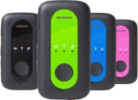

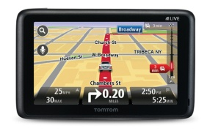
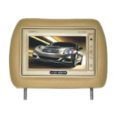
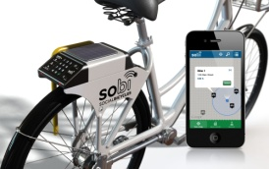
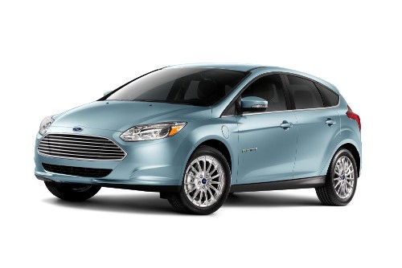

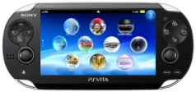
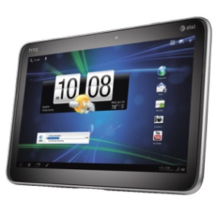
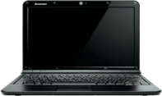
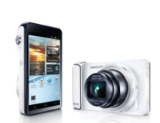
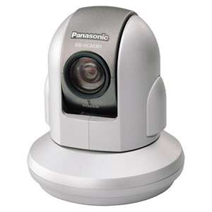
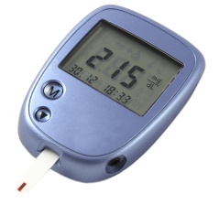



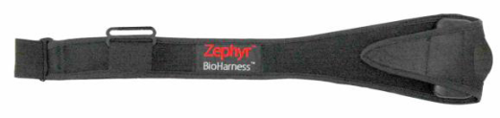
What’s Emerging
Tracking
Automotive
The AT&T
Networks
Wireless + Broadband
Wi-Fi + International
Computing
Consumer Electronics
Connected Home
Healthcare & Fitness
Notes:
Smartphones are driving a lot of this traffic, but not all. We’re adding new, connected devices to our network every day…from eReaders to tablets to gaming and tracking devices.
These new devices are driving out of our Emerging Devices organization - which is basically the group within AT&T that works to connect all things non-handsets to our wireless network
We call this chart our waterwheel chart – I won’t go over each of these, but wanted to give you a look at what’s helping drive new data growth.

Slide 3

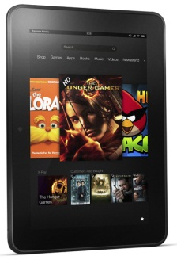
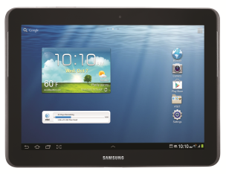
Reason for Success:
Flexible Business Models
Providing Options to Meet Customer Demand
Wholesale Data
Amazon Kindle
Transport included with the book
No subscription
No device subsidy
No connection between customer and carrier
Session Based Data
Kindle Fire HD
Buy monthly 4G data sessions as needed
No subsidies
OEM distributes and connects with AT&T experience
Postpaid Data
Samsung Galaxy Tab II
Subsidized device
2-year contract
Choose a 4G data plan; AT&T Mobile Share
Direct customer relationship with AT&T

Slide 4
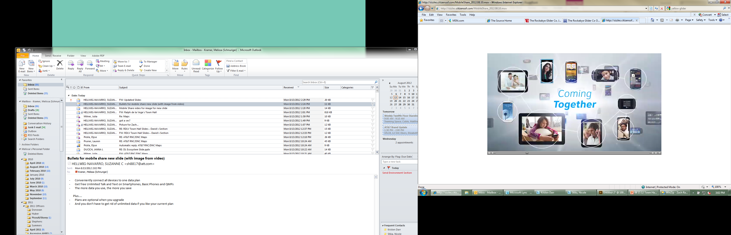
Connect up to 10 devices to one simple data plan
The more data you share, the more you save
Includes Unlimited Talk and Text on phones
We give you choice–
You may keep your existing plan you have today or select from either our individual or Mobile Share plans.
AT&T Proprietary (Internal use Only). Not for use or disclosure outside of the AT&T companies.
Notes:
We introduced our Mobile Share plans in August.
With our shared data plans, we decided to do what’s best for our customers--
That is let our customers choose what plan is best for them.
They may keep their existing plan,
move to an individual plan
or select our new Mobile Share plan –
it’s all about choice.
Now let’s take a closer look at Mobile Share….

Slide 5
Choose Your Plan
STEP 1: Choose your AT&T Mobile Share Plan | Per Month
 | 1GB | 4GB | 6GB | 10GB | 15GB | 20GB
Mobile Share with Unlimited Talk & Text | $40 | $70 | $90 | $120 | $160 | $200
 | + | + | + | + | + | +
Each Smartphone Unlimited talk and text | $45 | $40 | $35 | $30 | $30 | $30
STEP 2: Add more devices to your Mobile Share Plan
Basic & Messaging Phones | Laptops, LaptopConnect, Mobile HotSpot Devices & Netbooks | Tablets & Gaming Devices
Shared Data, Unlimited Talk & Text | Shared Data | Shared Data
$30 each/month | $20 each/month | $10 each/month
AT&T Proprietary (Internal use Only). Not for use or disclosure outside of the AT&T companies.
Notes:
Our base plan includes unlimited talk and text
The more data you purchase, the cheaper it is.
The more devices you add, the cheaper it is.
And now, with Mobile Share our customers can add a tablet
to their data buckets for just $10!

Slide 6

Home Security, Home Automation
All Digital, IP-Based
Wireless Centric
BYO Broadband
User-Friendly Interface
Flexible, Customizable
71
Notes:
I’m going to transition to another growth driver. It’s our Digital Life service that we announced in the Spring.
Digital Life will be our industry’s first all-digital solution for home security.
But it’s so much more than that … we believe it will take customers from home security and monitoring to a new level of home automation that nobody else is offering.
We’re trialing the service in Atlanta and Dallas now.
This is a game-changing solution. Up until now, alarm monitoring services have all been based on analog technology. We’ve come up with a whole new kind of platform.

Slide 7
Shape to shape
Notes:
From lots of perspectives, Digital Life is much more than just a new product … we believe it’s going to change the way people live, work and play.
We had a choice here. We could enter the traditional old home security marketing and compete.
Or we could step back … redefine the home security and home automation market … and lead the way through wireless innovation.
We chose the latter.
We look forward to announcing our commercial launch soon.

Slide 8
Chris Penrose
Senior Vice President, Emerging Devices, AT&T

