Slide 1



Michael Strübin
European Programme Manager, Continua
Renewing Health Industry Advisory Board
Connected Living European Summit
23-24 October, Gothenburg

Slide 2
Table of Content
It all takes time
RENEWING HEALTH in a nutshell
Not all of this is mobile health…
Current status
Conclusion

Slide 3
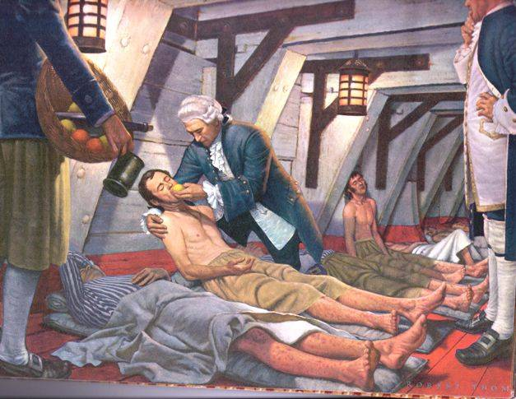
In 1747…
In 1747....
Scurvy = Skørbug/Skörbjugg/Skorbut/Niekingas/Keripukki/Szkorbut
Scurvy: massive impact on health, loss of lives, capacity to work/fight
Scottish physician James Lind tested 12 ill men with treatments including lemon juice (vitamin C) – among world’s first clinical trials
Successful – so the Royal Navy adopted lemon juice treament …
… 50 years later

Slide 4
… in a nutshell

Slide 5
Need for knowledge
EU commission found:
  Lack of high quality evidence on the effectiveness of telemedicine:
  A main barrier for wider use
2009: Call for proposals for a (large scale) pilot A, PSP-ICT project
2010: Renewing Health started

Slide 6
RENEWING HEALTH
in a nutshell
Project start date: 1 February 2010
Project duration: 47 months
Total budget: € 14.000.000
EU contribution: € 7.000.000
Nine EU regions, 26 pilot sites, ten clusters
Targeting three chronic conditions:
  Diabetes
  COPD (lung diseases)
  CVD (heart disease)

Slide 7
Notes:
7

Slide 8
Consortium
... comprises all relevant stakeholders:
  Regional health authorities
  Healthcare providers
  Telemedicine competence centres
  Patients and healthcare professionals (through their associations)
  Industry (through their associations)

Slide 9
Clinical objectives
improve the quality of life of patients with chronic conditions (diabetes, heart disease, lung disease) by
  alleviating anxiety about health condition
  reducing use of emergency services and/or hospital stays
  stabilising health status, avoiding complications
provide evidence that telemedicine can deliver healthcare services at least of the same clinical quality and reliability as those delivered by traditional healthcare

Slide 10
Economic objectives
contain the cost of care for chronic patients to maintain the health system sustainable in spite of the demographic changes
reduce the reliance of chronic patients on expensive care facilities and replacing them with more affordable homecare

Slide 11
Objectives
Tele-homecare
Quality of Life
Independent, Healthy Living
Community Clinic
Chronic Disease
Management
Doctor’s Office
Residential Care
Assisted Living
Acute Care
Skilled
Nursing Facility
Specialty Clinic
Community Hospital
ICU
Adapted from Intel
€1
€10
€100
€1,000
€10,000
11

Slide 12
Facts and figures
Size
  20 partners + 5 competence centres
  7.900 patients in the Intervention Group
  10 different telemedicine services (“clusters”)
International
  Regions from nine different countries in northern, central and southern Europe
Evaluation
  Randomised controlled trials
  MAST

Slide 13
Not all of this is mobile health...

Slide 14

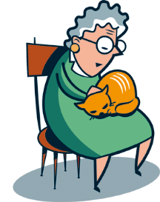
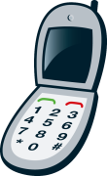
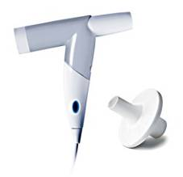
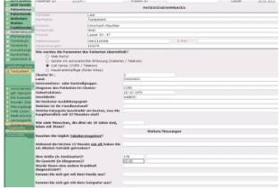
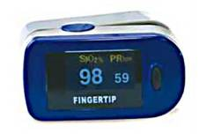
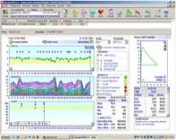
Example 1: COPD in Southern Denmark
^{Patient’s situation (at home)}
Hospital (Odense University Hospital & Svendborg Hospital)
PATIENT
PATIENT
BRIEFCASE
ALARM
6
HOSPITAL
INFORMATION
SYSTEM
NURSE
TELEMONITORING
DEVICES
HOSPITAL VIDEO
INTERFACE
2
1
3
4
MONITORING
5
©
DATA TRANSMISSION
DATA ACCESS
ALARM MANAGEMENT
14
Notes:
Validated
14

Slide 15
Cluster 4: COPD
Southern Denmark (DK)
A COPD patient admitted with exacerbation is discharged from hospital and a Patient Briefcase with video interface is installed in the patient’s home
Daily for 1-2 weeks, a specialised nurse will make a scheduled tele-consultation with the patient, who is at home
Through her computer at the hospital, the nurse can connect to the patient via video. Beside the video screen, she has access to the patient’s electronic patient record on a second screen
During the video consultation, the patient is asked to use the two measurement devices (spirometry and pulse-oximetry), which they received along with the Patient Briefcase
The data from the devices are transmitted through the Briefcase to a separate system at the hospital. The nurse can view the measurements on a third screen in her office. Based the conversation, observations and measurements, the nurse is able to assess the patient’s condition and take appropriate actions
If a patient experiences a worsening in their condition during the day, they can use an alarm button on the Briefcase and they are in direct contact with the hospital.
Notes:
Validated
15

Slide 16

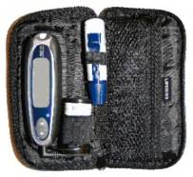
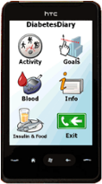
Example 2: T2 diabetes in
Northern Norway
^{Patient’s situation}
Intermediary Organisation Research server
PATIENT
TELEMONITORING
DEVICE
GATEWAY
& APP
DATABASE
GENERAL
PRACTITIONER
1
3
2
5
4
HEALTH COACH
RESEARCHER
©
DATA TRANSMISSION
GP ACCESS THROUGH CARE PORTAL (FUTURE!)
16
CONTACT BY HEALTH COACH, CLINICIANS (GP/SPECIALIST)
Notes:
16

Slide 17
Cluster 1: Mobile self-help tool for T2 diabetes (NO)
Patient set goals for what kind of food intake and physical exercise that is wanted the next period.
Patient measure blood glucose level with glucose meter
Glucose meter transfer data automatic to mobile phone by Bluetooth
Patient adds food intake and activity manually on the phone application
Patient gets response from application on how the personal set goals are met within the defined period.
Parallel activities to this registration process:
Patient will have contact with the health coach in parallel to using the application, where relevant health related questions and results are discussed.
The patients will have regular consultations with their physician where they will be able to share their application data, if they choose to do so.
Responsibility and control of their data lies 100% by the patient.

Slide 18
Current status

Slide 19
Clinical results
Renewing Health is the largest ongoing randomised study of telemedicine in EU
Total of 75 % of the patients are recruited
Eight PhD candidates are working on scientific dissertation in the pipeline
Results will be available in December 2013
(to maintain integrity of trial)

Slide 20
Industry results
Patient acceptance depends on computer literacy and affinity
User friendliness of the UI is key
Smartphone screens often too small for old patients (→ tablets)
Device interoperability remains a challenge

Slide 21
Next steps
Renewing Health successor project:
United for Health (2013-2015)
  New set of regions (led by Scotland)
  Common patient pathways and interventions
  More robust industry offerings
Large scale pilot on integrated care:
Smartcare (2013-2016)
  No more RCT
  Instead: periodic observations, no control group

Slide 22
In 1747…
In 1747....
Scurvy = Skørbug/Skörbjugg/Skorbut/Niekingas/Keripukki/Szkorbut
Scurvy: massive impact on health, loss of lives, capacity to work/fight
Scottish physician James Lind tested 12 ill men with treatments including lemon juice (vitamin C) – among world’s first clinical trials
Successful – so the Royal Navy adopted lemon juice treament …
… in the 1790s

Slide 23
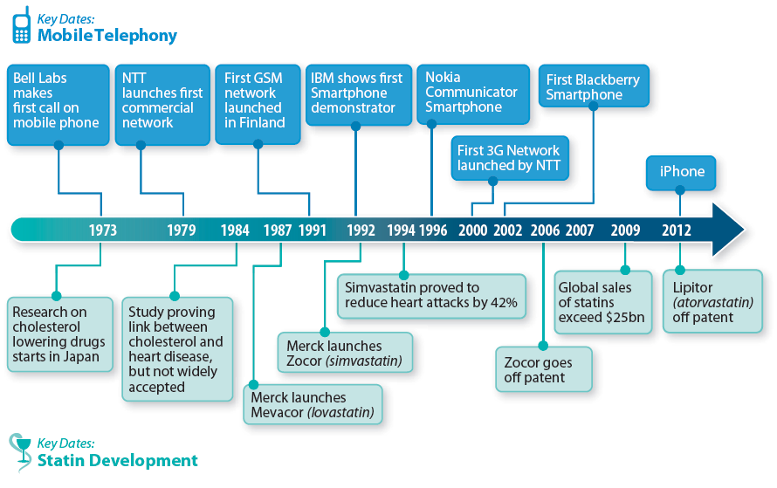

Conservatism of Healthcare
From AT Kearney, Mobile Health, Who Pays? (2011)

Slide 24
Conclusion
Clinical controlled trials take time
Mobile health field is rapidly evolving
Just do it!

Slide 25
Thank You for your attention

