Slide 1

John.Grumitt@idf.org

Slide 2
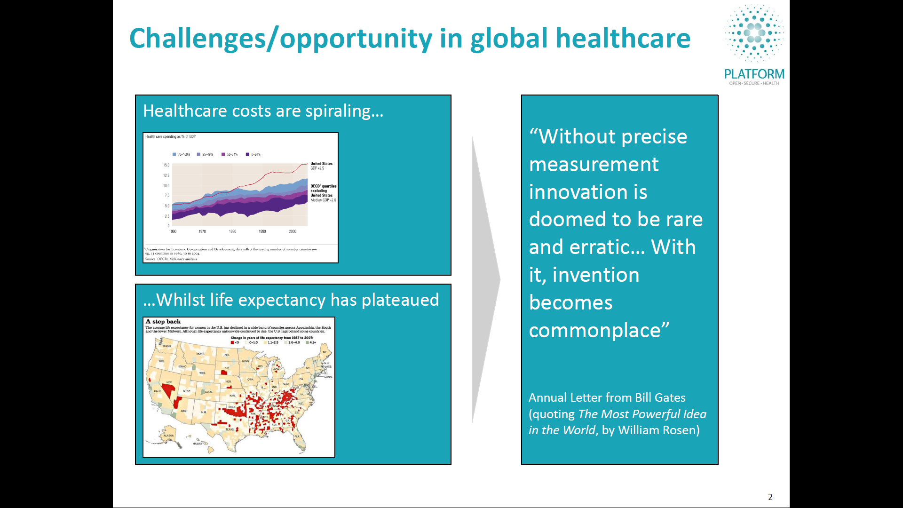
Global challenge… health data opportunity
Healthcare costs are spiraling…
“Without precise measurement innovation is doomed to be rare and erratic… With it, invention becomes commonplace”
2013 Annual Letter from Bill Gates (quoting The Most Powerful Idea in the World, by William Rosen)
…Whilst life expectancy has plateaued

Slide 3

2011-2030 Cost: $47 Trillion
3 Behaviors
Exercise, Nutrition, Smoking
4 NCDs
Cancer, CVD
Diabetes, Lung Disease
60% of deaths
36m avoidable p.a.
Up to 70% of spend is avoidable
Influence behavior Change:
Informed Decisions
Improve Use of Resources:
Access
Quality
Productivity
Opportunity is Global

Slide 4

Abu Dhabi: An ideal pioneer market for eHealth and tackling chronic disease
2.1m lives: “Big enough to matter, small enough to manage…”
Highly strategic government with broad-based popular trust
Extreme pace and depth of socio-economic development – very high burden of NCDs
Plural and diverse payers and providers
Relatively well-resourced health system enabling innovation

Slide 5
Abu Dhabi Case Study
Abu Dhabi took up a similar charter as WHO to tackle NCDs. Their journey began 5 years ago. Abu Dhabi took a data centric approach to analyze, monitor and manage the progression of NCDs across its population
Opportunity
Address data asymmetry to ensure Regulator is the most widely informed stakeholder in the health system, thus better able to regulate and address population-wide health issues
Create a low-cost, scalable, secure data exchange platform to support health entities to perform key functions, e.g., claims, authorisation, prescribing
Build a platform for population health promotion
The solution
Established a flexible and secured solution to exchange all transactions between payer and provider
Implemented an agreed upon data standard and format for all transactions
Implemented an agreed upon data standard and format for all data exchange
Establish Data Standards Panel and Data Access Panel to govern the ongoing management and access of data
Aggregated all transaction information to calculate statistics, conduct deep analytics and track health outcomes
Key challenges
Over 750 providers and close to 50 payers running vastly different systems
Integrating disparate systems had to be low cost and low complexity
Needed to address concerns of data privacy and security
Needed to ensure that payer and provider had ongoing input into how the data is exchanged and used
Outcomes achieved
Data transparency (e.g., Abu Dhabi Health Statistics – see www.haad.ae/statistics)
Unique Weqaya programme tackling NCDs (see http://bit.ly/x4VV4z) with significant measurable health improvement across the population

Slide 6


Proven model with 5-year track-record
Users of data
Health commissioners, insurers, academia, R&D industries
Back-end integration
Not “owner” of local impact…
‘Intel inside’
Platform Health
Standardised, scalable, adaptable integration layer
Data producers
Health facilities, health professionals, patients (e.g., self-care)

Slide 7
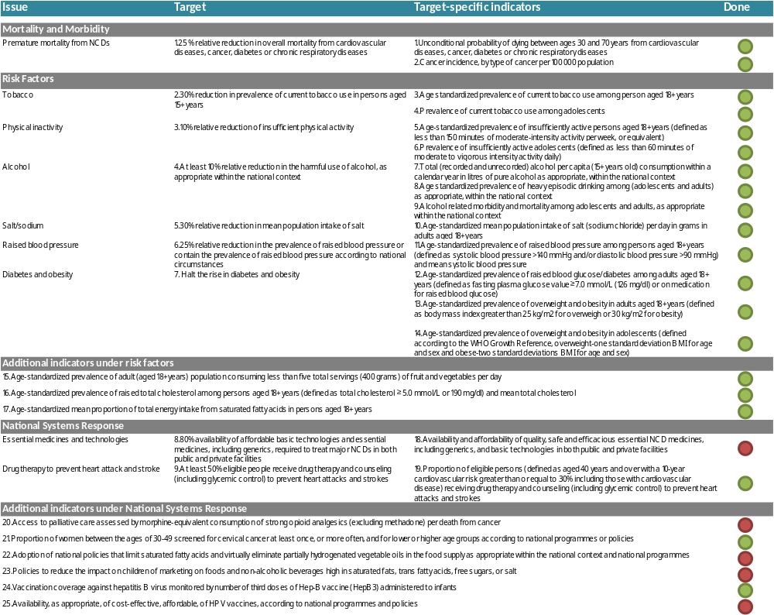
WHO Global Monitoring Framework on NCDs
Automated tracking of 20 of 25 indicators through our data systems
7

Slide 8
Standardised Health Data Dictionary
PERSON
Person
FirstName
ContactNumber
Birthdate
Gender
Nationality
City
PassportNumber
MEMBER
CONTRACT
ID
Relation
PackageName
StartDate
RenewalDate
ExpiryDate
GrossPremium
PolicyHolder
ENCOUNTER
ID
PatientID
FacilityID
Start
StartType
Type
End
EndType
TransferSource
TransferDestination
Financing
Encounter
DIAGNOSIS
Type
Code
Insurer
Health Provider
ACTIVITY
ID
Start
Type
Code
Quantity
Net
Clinician
PriorAuthorizationID
PaymentAmount
DenialCode
List
Gross
PatienShare
Claim
CLAIM
ID
IDPayer
MemberID
PayerID
ProviderID
Gross
PatientShare
Net
PaymentReference
OBSERVATION
Type
Code
Value
ValueType

Slide 9
Data can viewed across multiple dimensions
Provider Information
Patient Information
Facility Information
Diagnosis Information
Observation Information
Treatment Information
Health Analytics Hub
Multi-dimensional Cube
Cost Information
Prescription Information
Time
www.haad.ae/statistics
www.haad.ae/statistics-xl

Slide 10
Multi-dimensional, multi-use
Multi-dimensional data schema
Time and date
Identifier: Patient
Identifier: Facility (where applicable)
Identifier: Health Professional (where applicable)
Diagnosis (single or multiple) (where applicable)
Activity (e.g., screening, treatment)
Prescription: Drugs and/or medical devices (where applicable)
Observation (results of, e.g., clinical measurement or laboratory testing) (where applicable)
Costs (where applicable)
Multi-dimensional data cube
Multiple uses (examples)
Electronic patient record
Single patient identifier, all available data
Physician and Facility clinical audit (performance management)
Single health professional or facility, all available data
Burden of disease data
Single diagnosis (or cluster of diagnoses), all available data
Pharmaceutical utilisation data
Single drug (or cluster of drugs), all available data
Pharmaceutical effectiveness/cost-effectiveness
Single drug (or cluster of drugs), diagnosis and outcome data
Etc.
Health Analytics Hub
Multi-dimensional Cube

Slide 11
Overview of Weqaya
Approach
Screen Screen individuals iteratively
97% adult Emiratis screened (>190,000)
Plan Clinical Standards, website/call centre
Act Clinical care, targeted lifestyle behaviour change (diet, physical exercise, tobacco)
PLAN
SCREEN
ACT
Interventions
Population Standard clinical care
Nutrition (trans-fats, food labeling)
Physical activity (gyms, AD UPC)
Tobacco control
Group Workplaces and schools
Local communities, families
Segments: Disease groups e.g. diabetics
Individual Clinical care
Encourage: Weqaya reports
Enable: Website/call centre
Population
Group
Individual

Slide 12
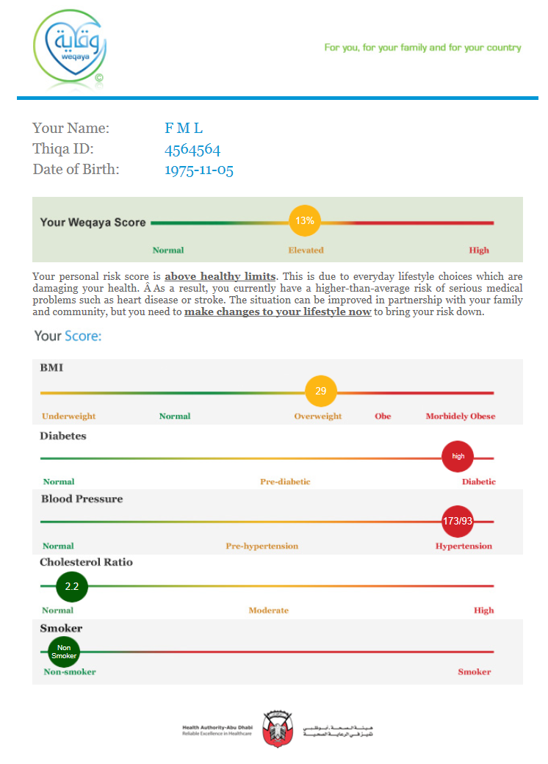
Patients can access their health data
Personal Health Record (secure paper mail-out)
Electronic Health Record (www.weqaya.ae)
Smart Portable Health Record (Weqaya Data Architecture)

Slide 13
eHealth systems are a platform for health
Weqaya Programme tackling heart disease – early outcomes
Everyone can know their numbers…
… and the numbers can change health outcomes
% engaged with care*
% with HbA1c <7.5%
% with LDL:HDL ratio <3.5
2008
2009
2010
Control
Weqaya
Control
Weqaya
Control
Weqaya
Source Health Authority – Abu Dhabi (2010 full-year data); OLAP cubes analysis

Slide 14
3 Behaviours
Diet, Exercise,
Tobacco
4 NCDs
Diabetes, CVD,
Cancer, Lung Disease
60% of deaths, 36m lives a year
John.Grumitt@idf.org

