Slide 1

Future Vision for Connected Vehicles: How can Big Data Enable Services?
Enrique Herrera
Sr. Business Strategy Architect
Enterprise Strategy Services
26-February 2013
Mobile World Congress
Barcelona

Slide 2





Technology trends accelerating business evolution
Mobility
Social
Cloud
Big data
Social connections, mobility, cloud delivery and pervasive information are converging in a powerful way. This convergence is creating a new era of computing and new opportunities for business.
– Gartner, August 2012
Notes:
Timing: 6 minutes
Key Points:
In order to remain competitive, businesses must adapt and change.
Today, more than ever, technology trends such as big data, cloud computing, mobility, social business, and apps are both a force of change and an enabler of business evolution.
The accelerating pace of technology changes demands the blurring of the traditional lines between the IT department and the business to anticipate and get ahead of the challenges and opportunities represented by these trends.
Script:
To remain competitive, businesses must adapt and change. The process of business evolution is constant. It is what keeps businesses relevant and viable in a changing marketplace. It’s not just evolution for the sake of evolution. There are inevitably changes in the way that people prefer and need to interact today, and our technology and business processes need to adapt to drive the right governance, organizational productivity, and customer satisfaction. Business evolution could be a series of incremental, small changes or a radical transformation. Ultimately, the goal is to maintain or—preferably—improve the way the company does business.
Business evolution is an unavoidable topic for enterprise executives facing ongoing economic and competitive challenges. The way that people are adapting to these challenges and addressing trends related to technology usage play a pivotal role: both as a forcing function and an enabler for evolution. These trends are forcing businesses to re-evaluate everything from their business model to their staffing strategy to their customer approach in order to remain competitive:
Big data. We live in a “save everything” culture. This, combined with an immense number of digital devices, means that data continues to grow on a massive scale. According to statistics from IDC, data use (or “the digital universe”) is expected to grow by as much as 44 times to 35 zettabytes (ZB) [a zettabyte is a trillion gigabytes] globally in 2020. Deep analysis of these vast stores of data represents new opportunities for you to better understand and delight valuable customers, develop targeted products and services, maximize productivity, and improve business processes.
Cloud computing. First mover advantage is elusive: new services can often take 12 months or more to deploy. With its massive data centers, cloud computing delivers virtually infinite resources, helping organizations scale more quickly and reduce the costs of running services within their own IT environment. The cloud provides the storage capacity and processing power to tackle some of the toughest problems and opportunities facing businesses in virtually every industry. In addition, it provides a platform that can help transition the time and resources spent on tactical IT functions to projects that differentiate a business. It strategically orchestrates the flow of information and technology across people’s lives so that they always have instant access to the tools and information that they need. This has the potential to fundamentally change the way your business runs and the services you offer.
Mobility, social business and the apps that enable these trends. Providing this instant access to information can also have a profound effect on people’s expectations for and use of technology:
Mobility. Mobility is quickly becoming the norm as people increasingly blend their personal and business lifestyles and companies rely on a more geographically distributed and remote workforce. This trend is underpinned by a surge in the number of mobile device form factors available, from smartphones to tablets. It represents new opportunities for you to rethink how and where your employees work, to deliver new options for engaging with your customers and partners, and to create new offerings that tap into the wealth of location-based data available through smart mobile devices.
Social business. Social computing has already changed how people create and maintain their connections with others. As social networks and social media have become a foundation for how people interact in their personal lives, it is having an equally dramatic effect on how businesses operate, both internally and in their interactions with customers and other external stakeholders. The social business demands a significant evolution of functions across the business, from marketing to customer service to research and development (R&D).
Apps. Marketplaces for the major device platforms are changing how users select, install, and maintain the tools they use. In the enterprise, IT is no longer the only place to get apps, and users are increasingly self-selecting the apps they use to get their jobs done. Likewise, apps are becoming a core channel for how customers interact with businesses. This trend is destined to continue to expand onto more devices, including the desktop, increasing the pressure on IT to provide clear and compelling app options for employees and customers alike.
These areas are all part of the consumerization of IT trend. They are forcing the IT department to adapt to changing consumer expectations and respond to both the challenges and opportunities that this represents.
With the accelerating pace of technology change today, the implications of these trends extend far beyond your IT department. The emerging generation of digital natives is accustomed to making its own technology decisions and building its own solutions. Business evolution and transformation enabled by technology cannot be carried out in isolation, or the IT department runs the risk of becoming a bottleneck, which in turn increases the likelihood that business units will develop their own technology solutions. The challenge for CIOs is to blur the line between IT and business to get ahead of the opportunities and challenges represented by new technology.

Slide 3
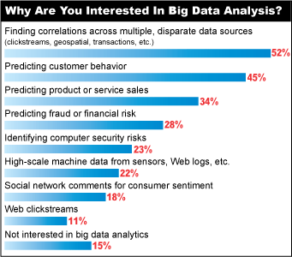
What is Big Data?
Data Volume
Terabytes
Petabytes
Data Variety
Structured
Unstructured
Data Velocity
Batch
Streaming
Data: InformationWeek 2013 Analytics, Business Intelligence and Information Management Survey of 417 business technology professionals at companies using or planning to deploy data analytics, BI or statistical analysis software, October 2012

Slide 4


Volume and Value Relationship
CONSUMER
ASSET
Big Data &
Analytics
Value to Consumer
Value to Business Network
Amount of data
Amount of data

Slide 5













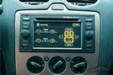



Connected Vehicle Ecosystem
Platforms
Business participants
Consumers
Relationship
Management
Commercial
Dealer/Retailer
Data
Service providers
Aftermarket
Cloud
Content providers
Connectivity
Enterprises
Mobile Network
Operator
Client software
Customers
People and
devices
Auto
Manufacturer
Hardware

Slide 6
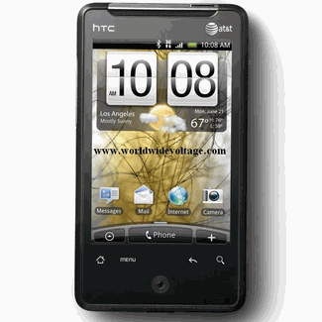









Delivering Agile Multi-Cloud Services
A
Multiple Devices / OSs
Android
iPhone
iPAD
Phone 8
Windows 8
Automobile
B
Developer Ecosystems
  Internal “IT Pro”
  External 3rd Party
Great User
Experience
1
Reference Architecture for
Multi-Cloud Service Delivery
& End-to-End Management
Great Developer Experience
2
C
Rapidly growing & confusing array of APIs, SDKs
Great Operations Experience
3
Interoperability Surface
D
Other Provider
Communications Service Provider
Microsoft
Multiple Clouds / Service Domains
Private / Public Cloud
Telecom Private Cloud
Fixed / Wireless Network “Cloud”
BSS / OSS “Cloud”
(Public)
(Private)

Slide 7
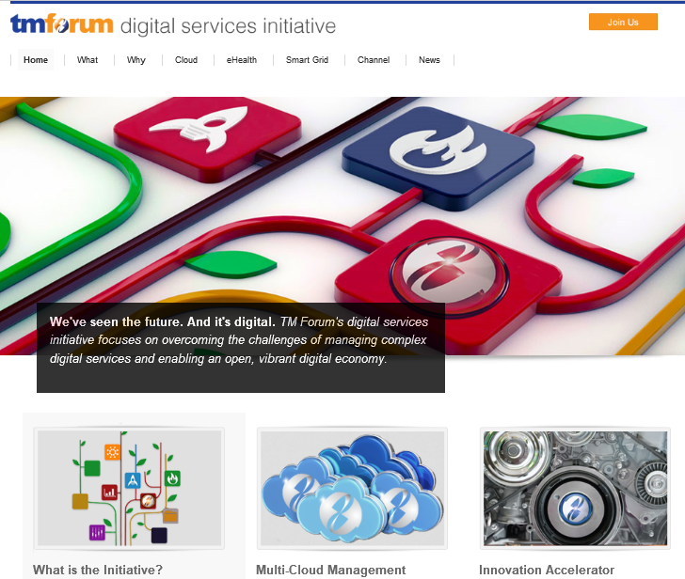
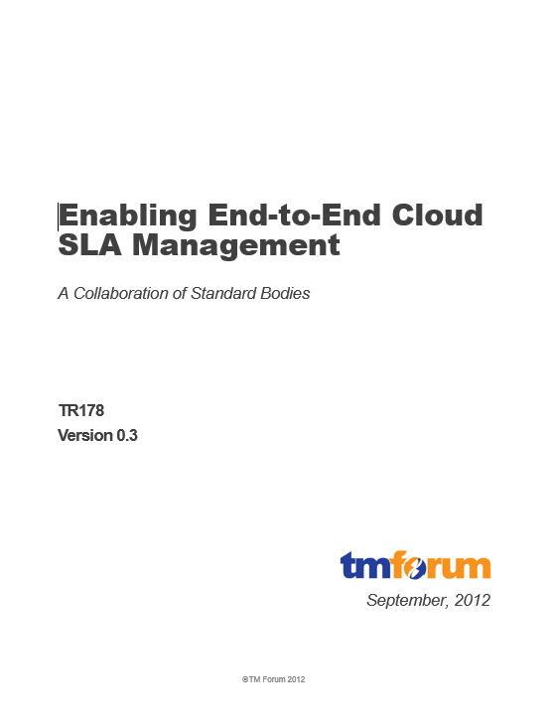
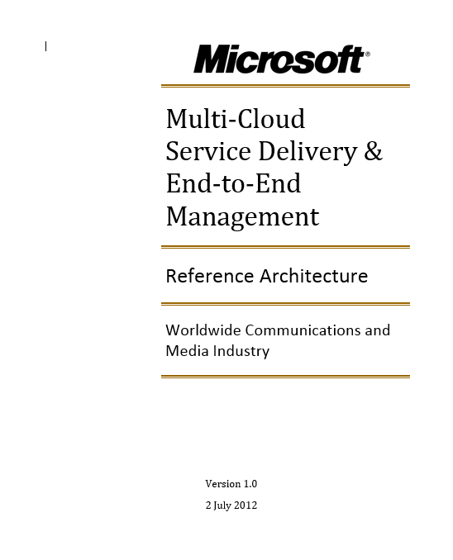
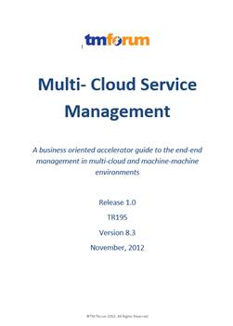
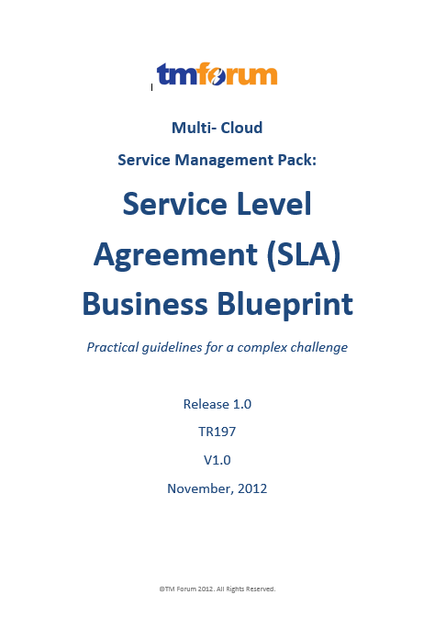
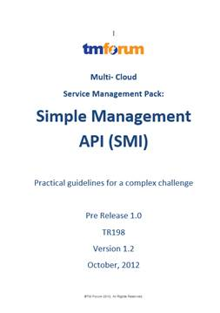
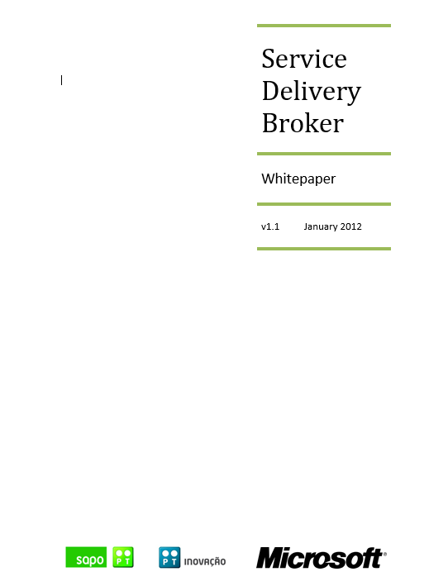
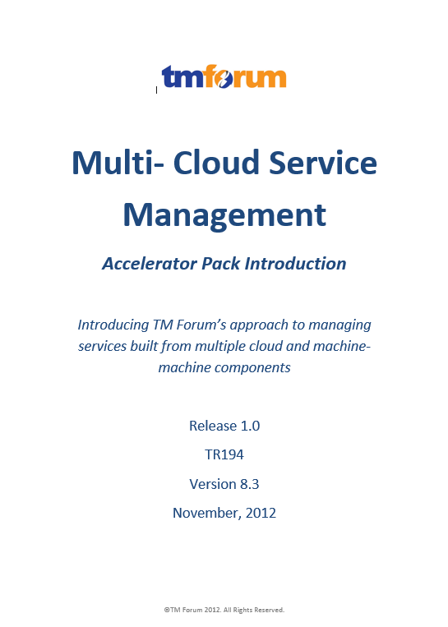
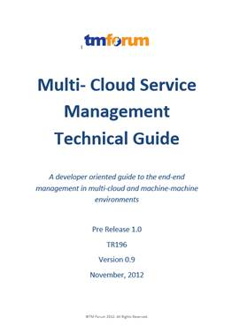
Industry Impact on Multi-Cloud Conversation

Slide 8
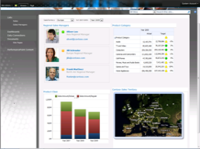
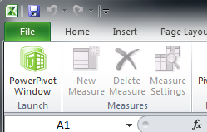



A holistic BIG DATA Approach spanning relational and non-relational Worlds
INSIGHTS
SELF-SERVICE
MOBILE
OPERATIONAL
REAL-TIME
PREDICTIVE
COLLABORATIVE
External Data and Services
DATA ENRICHMENT
MARKETPLACE
DISCOVER
AND RECOMMEND
TRANSFORM
AND CLEAN
SHARE
AND GOVERN
DATA MANAGEMENT
1
1
1
0
0
1
RELATIONAL
NON-RELATIONAL
MULTIDIMENSIONAL
STREAMING

Slide 9
Data Marketplace Scenarios
Data collected and accessible only to organization that collected it. Insight can be enriched with additional data sets and presented in context (eg. Engineering, Quality, Marketing)
Community
A subset of Data collected Can be shared with SPECIFIC partnering organizations. Insight can be drawn across multi-organizational data sets.
Public
Data can be anonymized and placed in marketplace for any third party to consume. Ability to monetize.
Private
Big Data &
Analytics

Slide 10
Takeaways
Focus on delivering and realizing VALUE through the ecosystem
Interoperable, Flexible and Scalable platforms are the enablers
Information is the currency

Slide 11
Contact
Enrique Herrera (USA)
eherrera@microsoft.com
+1 734 377-6080
ConnectedVehicles@microsoft.com

