Slide 1

5G
Moving from a technical
to a business perspective

Slide 2

Welcome
Henry Calvert
Head of Network 2020
GSMA

Slide 3
Moderator
David Pringle

Slide 4
Bruno Jacobfeuerborn Group CTO & Chair of Network 2020 Deutsche Telekom
Notes:
STAY on this slide (Bruno doesn’t have slide for his presentation)

Slide 5
Panel

Slide 6

Moderator - David Pringle
Panelists
Dan Warren, Samsung
Peter Virk, Jaguar Land Rover
Seizo Onoe, NTT DOCOMO, INC
Adam Koeppe, Verizon
Notes:
Called to stage in reverse order – so Adam joins last but is first to present.

Slide 7
Adam Koeppe
VP, Access Technology Planning
Verizon

Slide 8
Verizon 5G.
Adam Koeppe, VP
Technology Planning
February 2017

Slide 9
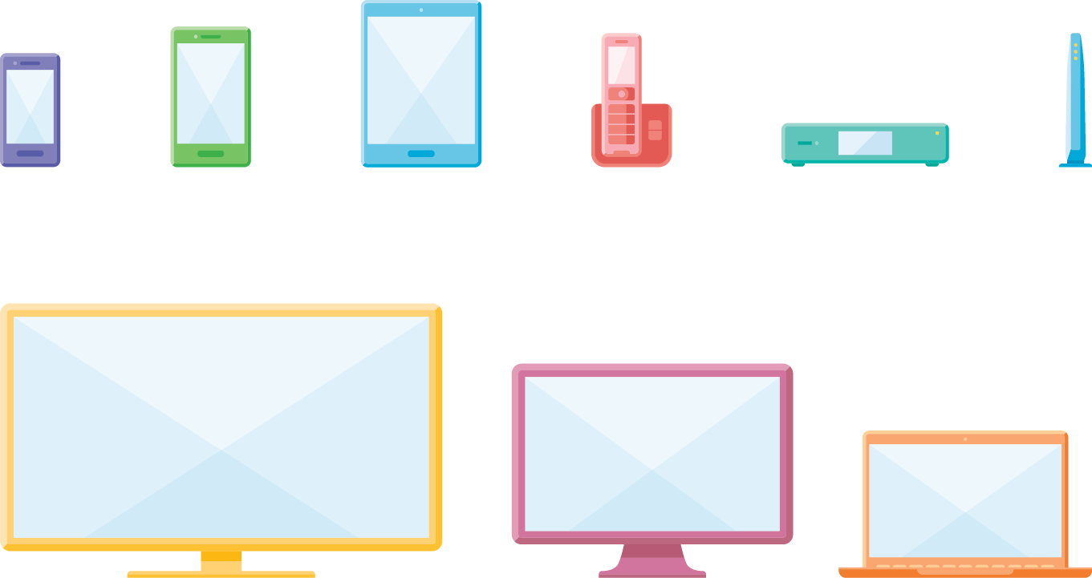













Wide range of technical development.
  Enhanced fixed
  and mobile broadband
  Massive connection/usage scale
5G
  Multi Gbps peak data rates
  Billions of connected
  things interacting
4G
  M2M ultra low cost
  Ultra reliability
  Multi-year Battery
  Low latency services
    Robotics
    Remote control
    Autonomy
  Billions of devices
  with different needs
  GBs transferred
  in an instant
  Mission-critical
  control and automation

Slide 10
Verizon 5G snapshot.
5G Tech Forum
Innovation sessions across infra, chipset, device, VC partners
Field technical trials
Robust real-world testing
Public specifications
5GTF spec published, development underway
Pre-commercial customer pilots underway
Largest 5G test bed for fixed and mobile
Verizon is leading and accelerating the 5G evolution

Slide 11









5G enables new opportunities & markets . . .
Autonomous Vehicles Drones
Underserved
Home Broadband
Smart Cities
Mission Critical IoT
Mobility
4G LTE Advanced
FTTP
Fixed Wireless
Virtual Reality
Augmented Reality
Immersive Video
Mobile
Broadband
Massive Connectivity
5G Value
VoLTE
TODAY
Ultra-fast
Video
Low Latency
Wi-Fi Phone
Verizon 5G rapidly extending beyond Fixed Wireless

Slide 12






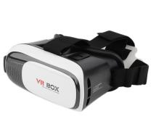










. . . and a broad set of new use cases.
Latency
1 ms
Autonomous
Vehicles
High Frequency
Trading
Mission
Critical IoT
Drones
AR
10 ms
Gaming
VR
Telemedicine
Assisted
Driving
Market value and revenues
VoLTE
Automated
Industry
100 ms
Smart
Cities
Mobile
Broadband
Mass IoT
High Bandwidth
Home
Wi-Fi Phone
Ultra-fast Video
Bandwidth
1000 ms
<1 Mbps
1 Mbps
10 Mbps
100 Mbps
>1 Gbps
Today
Bandwidth
Future
Bandwidth • Latency • Connectivity
Value Measure

Slide 14
Seizo Onoe
CTO and EVP
NTT DOCOMO, INC

Slide 15

The Brooklyn 5G Summit
GSMA Network 2020: 5G Beyond Technology into Business Impact, Barcelona, 27 Feb 2017
5G Potential and Reality
Seizo ONOE
CTO and EVP
NTT DOCOMO, INC.

Slide 16



Slide 17

eMBB
eMBB
New Business Models and Ecosystem across Industries
mMTC
uRLLC
mMTC
uRLLC

Slide 18
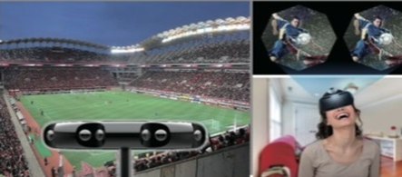


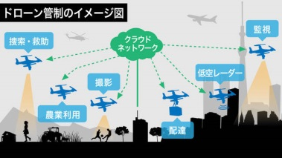


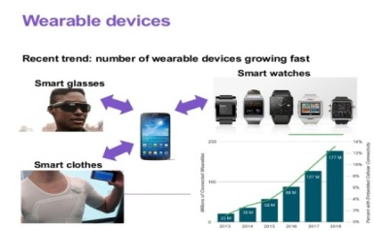


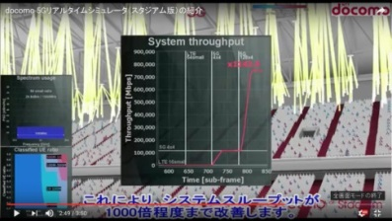

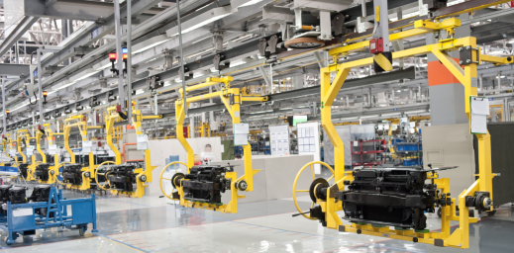
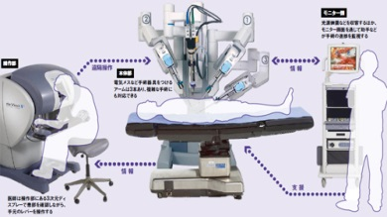
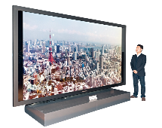

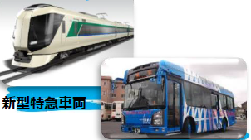


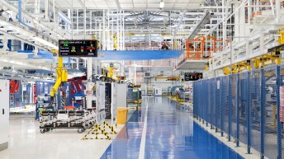
eMBB
mMTC
uRLLC
Virtual Reality
Augmented Reality
Smart City/Home
Drone Management
Free-viewpoint
Sense of Presence
Wearable
Tactile sensation Communication
High density traffic
Uplink Traffic
Smart Manufacturing
Remote Operation
New Business Models and Ecosystem across Industries
Broadcast
Automotive
Transportation
Medical/Healthcare
Agriculture
Manufacturing

Slide 19
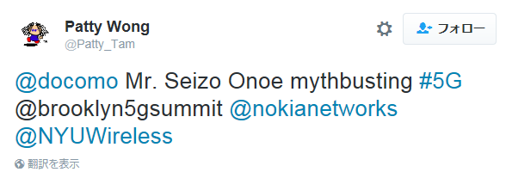
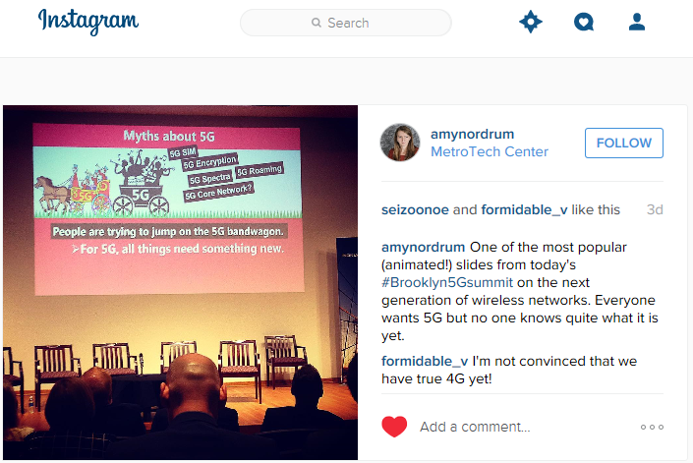
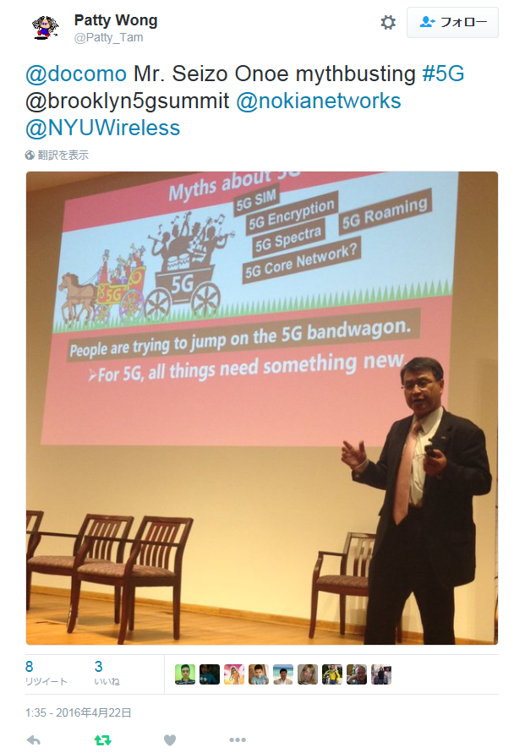

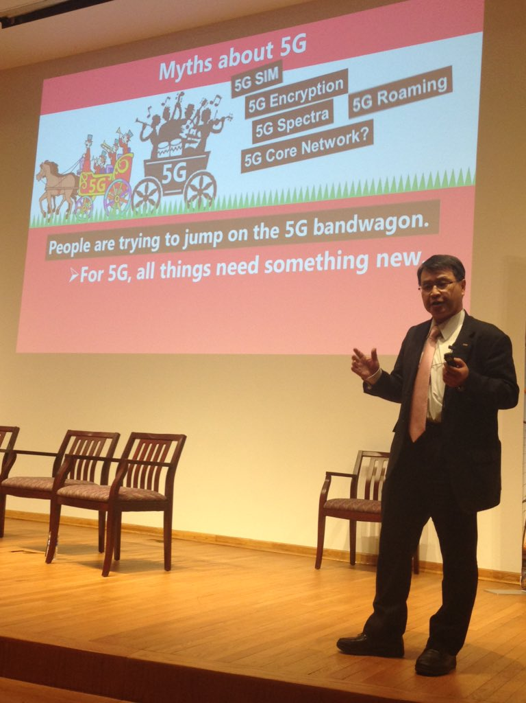

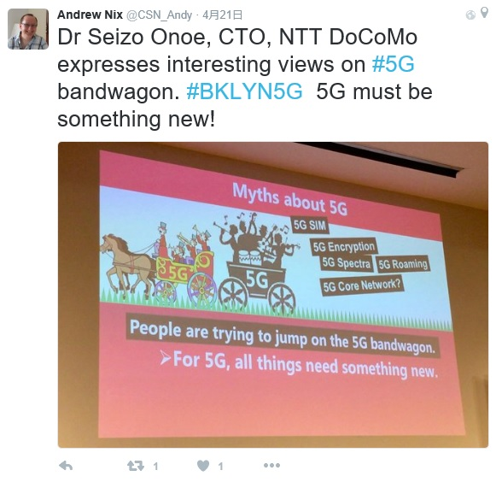
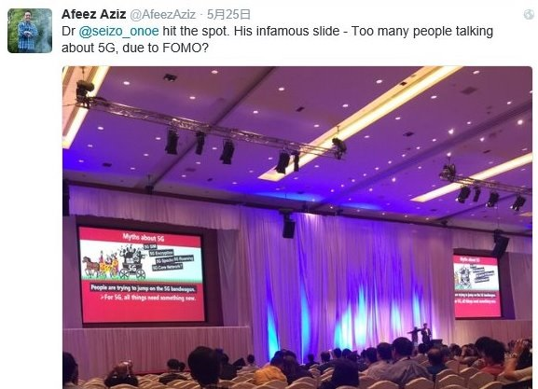
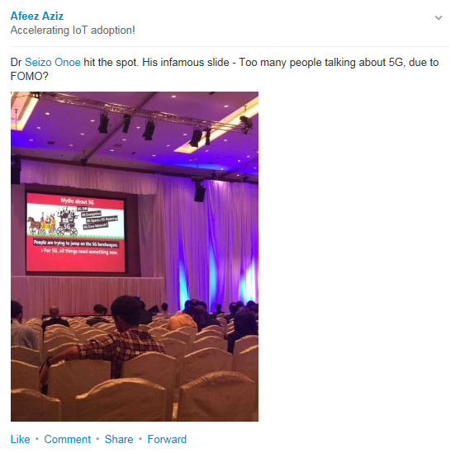
Myths about 5G
5G is millimeter wave technology.
5G is a hot spot system.
5G launch needs new 5G spectra.
5G is IMT-2020 defined by ITU.
5G replaces 4G.
For 5G, all things need something new.
5G needs significant investment.
5G SIM
5G Encryption
5G Roaming
5G Spectra
5G
5G
5G Core Network?
People are trying to jump on the 5G bandwagon.

Slide 20
Myths about 5G
5G is millimeter wave technology.
5G is a hot spot system.
5G launch needs new 5G spectra.
5G is IMT-2020 defined by ITU.
5G replaces 4G.
For 5G, all things need something new.
5G needs significant investment.
5G SIM
5G Encryption
5G Roaming
Let’s get on the 5G bandwagon
and create new business models
through collaborations across industries.
5G Spectra
5G
5G
5G Core Network?
People are trying to jump on the 5G bandwagon.

Slide 21


DOCOMO’s Time Plan
2014 | 2015 | 2016 | 2017 | 2018 | 2019 | 2020 |  | 202x
Research, Experiments
System Trials
5G
launch
Development
5G 5G+ ・・・
Study Item
Rel. 16
Rel. 15
Rel. X
IMT-2020
Requirements
Proposals
Specifications
WRC15
WRC19

Slide 22





Collaborations with various industries
Ongoing Collaborations for 5G Trials
Broadcast
Automotive and components
Transportation
Construction Machinery
Others
Contact and Information Exchange

Slide 23
Myths about 5G
5G is millimeter wave technology.
5G is a hot spot system.
5G launch needs new 5G spectra.
5G is IMT-2020 defined by ITU.
5G replaces 4G.
For 5G, all things need something new.
5G needs significant investment.
A vague sense of worry

Slide 24
The data capacity enhancement with no increasing trend in CAPEX can be one of the 5G killer services.
Data Traffic
3G launch
2001 Oct. 1
LTE launch
2010 Dec. 24
Log scale
10X
Billion Yen
1000
10X
800
Capital Expenditure
at DOCOMO
600
10X
400
200
10X
0
2000
2005
2010
2015

Slide 25

Conclusion: 5G Potential
eMBB, mMTC and uRLLC will provide various use cases for enterprises and consumers.
5G will create new business models and ecosystems through collaborations across verticals.
The capacity enhancement with reasonable CAPEX can be a killer service.

Slide 26
Conclusion: 5G Reality
There is no service that can be provided only in 5G
and not in 4G.
A service that is reasonably good in 4G but surprisingly better in 5G is a “5G” service.
5G will not change the world overnight, but over time.
5G networks and devices will not be built or deployed in a day.
Users themselves create new use cases.
In the past generations, telecom carriers designed services for the next generation; but those actually became popular were unexpected ones that had been created by someone else.
It is a fact that 5G is attracting interest from a wide variety of industries.
We should not miss the potential of 5G as a business opportunity for creating new business and services.
The services that actually became popular after the launch were different from ones that were expected before the launch.

Slide 27
Peter Virk
Director of Connected Technologies & Apps - Connected Car
Jaguar Land Rover

Slide 28

InControl
Sales Panel Update
11 March 2015
PETER VIRK
DIRECTOR OF CONNECTED TECHNOLOGIES & APPS
JAGUAR LAND ROVER
Feb 2017

Slide 30





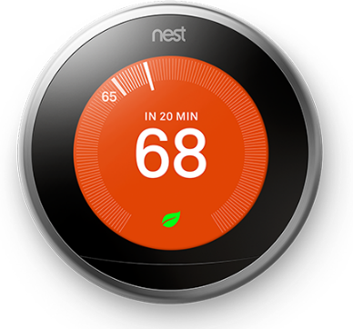

TIMES HAVE CHANGED

Slide 31



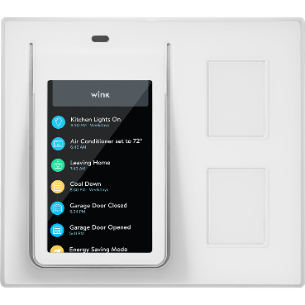



TIMES HAVE CHANGED
1960’s Jaguar E-Type
New Jaguar XF

Slide 32

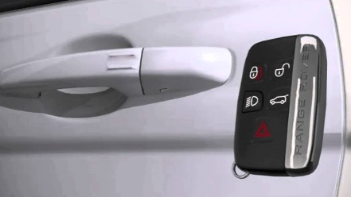
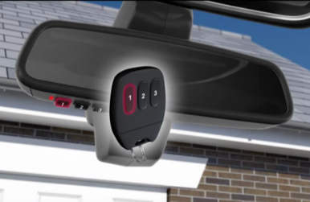
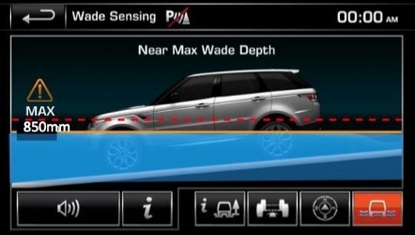




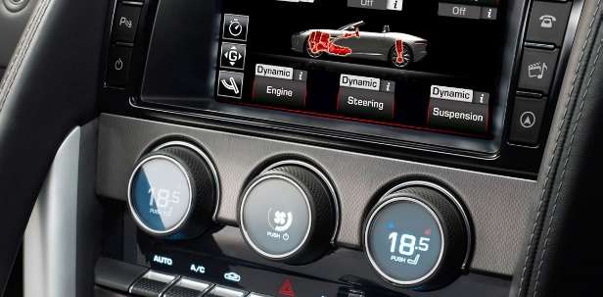
Automotive of Things

Slide 33

Notes:
Multiple network operators
Varying interfaces
Few common approaches
‘First come, first served’ data service

Slide 34


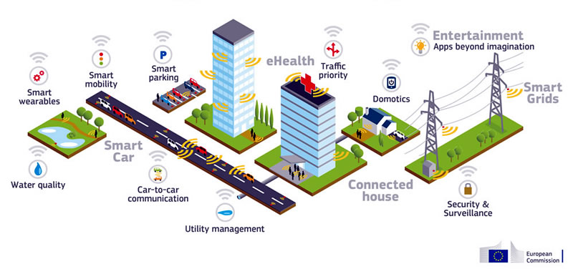
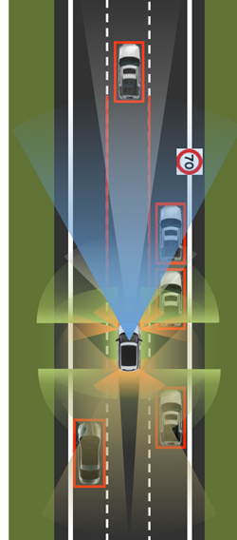

Slide 35

PETER VIRK
DIRECTOR OF CONNECTED TECHNOLOGIES & APPS
JAGUAR LAND ROVER

Slide 36
Dan Warren
Head of 5G Research Samsung R&D Institute
Samsung

Slide 37
5G requirements to tech to business
Requirements
Applications
Customer segments
MNO biz model
10x bandwidth per connection
Low-ms latency
Five 9’s reliability
100% coverage
>10x connections
50Mbps per connection everywhere
More cells
1000x bandwidth
Connected vehicles
AR/VR
S-UHD/3D Video
Haptics/Sensing
Massive IoT
Remote machine control
Mission critical services
Fixed-wireless access
eMBB
…
Consumer
Auto industry
Health
Industry 4.0
Agriculture
Smart City/Public sector
Smart building
Utilities
Education
…
B2C
B2B
B2B2C
The MNO is the first ‘B’

Slide 38
5G meets all requirements - implications
Requirements
The positive message…
Bandwidth is no longer an application limitation
Coverage is no longer a limitation
Reliability and availability is assured
10x bandwidth per connection
Low-ms latency
Five 9’s reliability
100% coverage
>10x connections
50Mbps per connection everywhere
More cells
1000x bandwidth
The competitive implication
Bandwidth is no longer a differentiator
Coverage is no longer a differentiator
Reliability and availability are no longer differentiators
So, how will operators differentiate
themselves from one another?

Slide 39
The significance of being the first ‘B’
When you are the first ‘B’ in a B2B or
B2B2C value chain, your price is the
other B’s cost
As a consequence, the second B will squeeze
the first B’s margins, reducing first B’s profit in
order to increase the second B’s

Slide 40
B2B engagement brings different expectations
The positive business impacts
Big contracts, lots of connections
Addressing previously untapped markets
New revenue streams
Customer segments
Requirements
Consumer
Auto industry
Health
Industry 4.0
Agriculture
Smart City/Public sector
Smart building
Utilities
Education
…
10x bandwidth per connection
Low-ms latency
Five 9’s reliability
100% coverage
>10x connections
50Mbps per connection everywhere
More cells
1000x bandwidth
The implications
Contractual SLA’s that must be met
Significant penalties for failure to deliver
Commercial and reputational damage if a contract is lost
Some ‘Requirements’ become ‘Contractual Obligations’
Significant CapEx and OpEx to deliver and maintain these metrics
Significant penalties incurred with failure to deliver and maintain

Slide 41
Some thoughts…
What is 5G’s business motivation?
Is it delivering high availability, high coverage, low latency (and sometimes high
bandwidth) connections to enable parallel industry opportunities to be addressed?
Or is it enhanced mobile broadband for consumers? Or both?
5G is a long journey, not a single network launch
Early 5G launches will still deliver technical advances that offer MNOs differentiation
on basis of connection bandwidth.
… but as more networks launch, parallel industries will expect coverage, latency and
availability promises to be met.
These are MNO investment dependent, not technology dependent.
Therefore, MNOs must either invest in meeting all 5G requirements, and find the
associated business cases that work…
… or face up to 5G being a consumer network that is just ‘faster than 4G’.

Slide 42
Panel debate

Slide 43
Audience questions

