Slide 1



Oscar Gallego
Global Head of Smart Communications & Security
Vodafone

Slide 2
Vodafone RCS Messaging:
Ready for Business
Oscar Gallego
Vodafone Group
GSMA Mobile World Congress 2018

Slide 3
Vodafone’s RCS journey
Modernising SMS
Scaling
Monetising
Enhance customer experience
Benefit from SMS universal reach
100% coverage of Android base
14 countries ++
97 interconnects ++
MaaP UP2.0 ready with trials ongoing
Successful SMS A2P experience

Slide 4
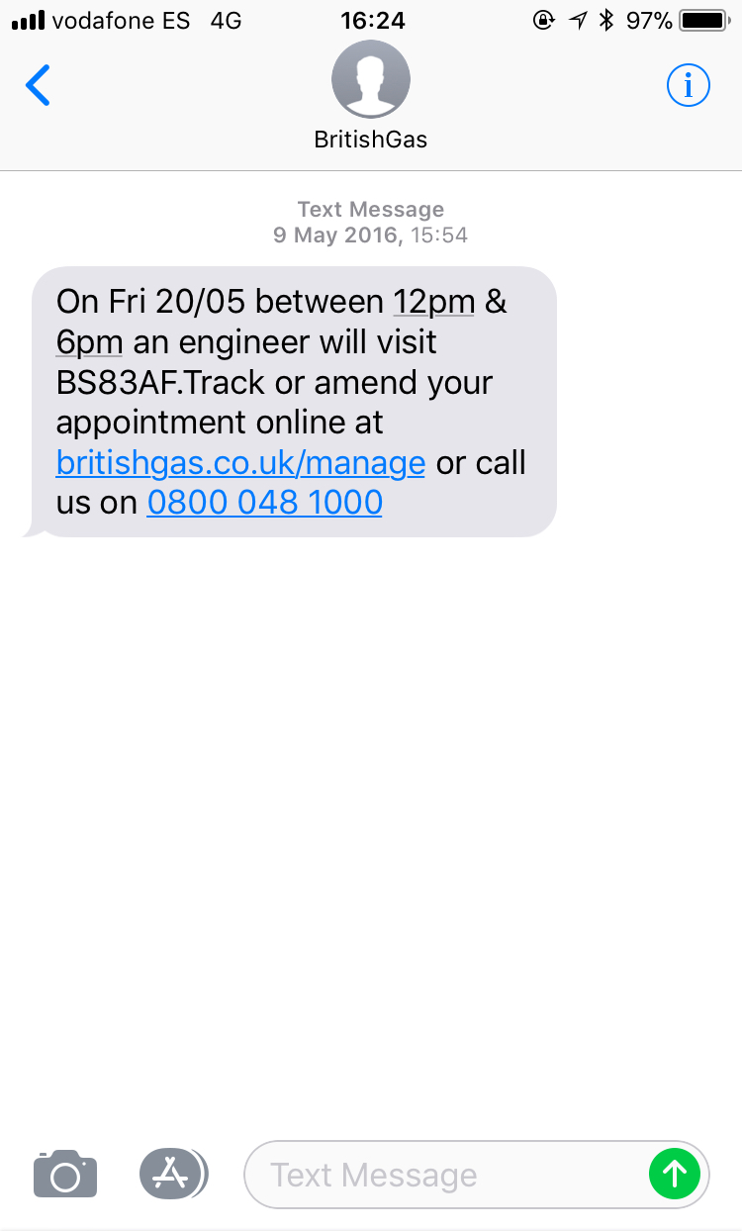
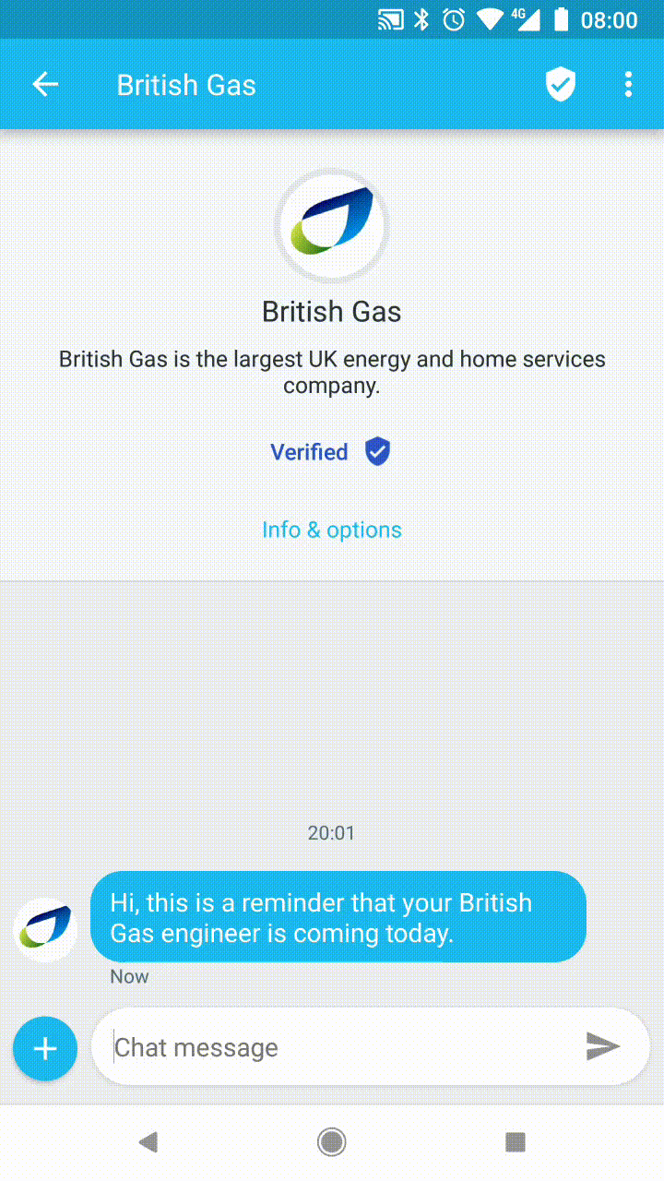


Application to Person Messaging is evolving thanks to RCS

Slide 5
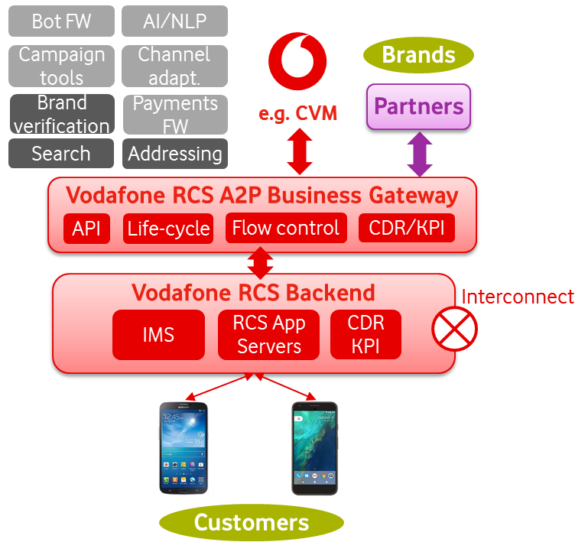
Vodafone RCS A2P Messaging Platform – Ready for business
Messaging ecosystem design for brands, including Vodafone
Lightweight integration enabling access to the RCS ecosystem
Central platform enabling P2P functionality and interconnect reach
100% reach for Android Devices

Slide 6

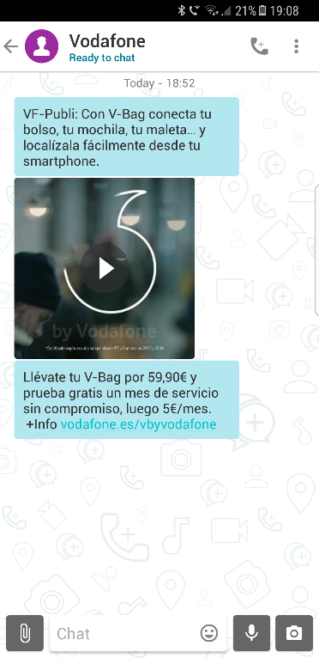
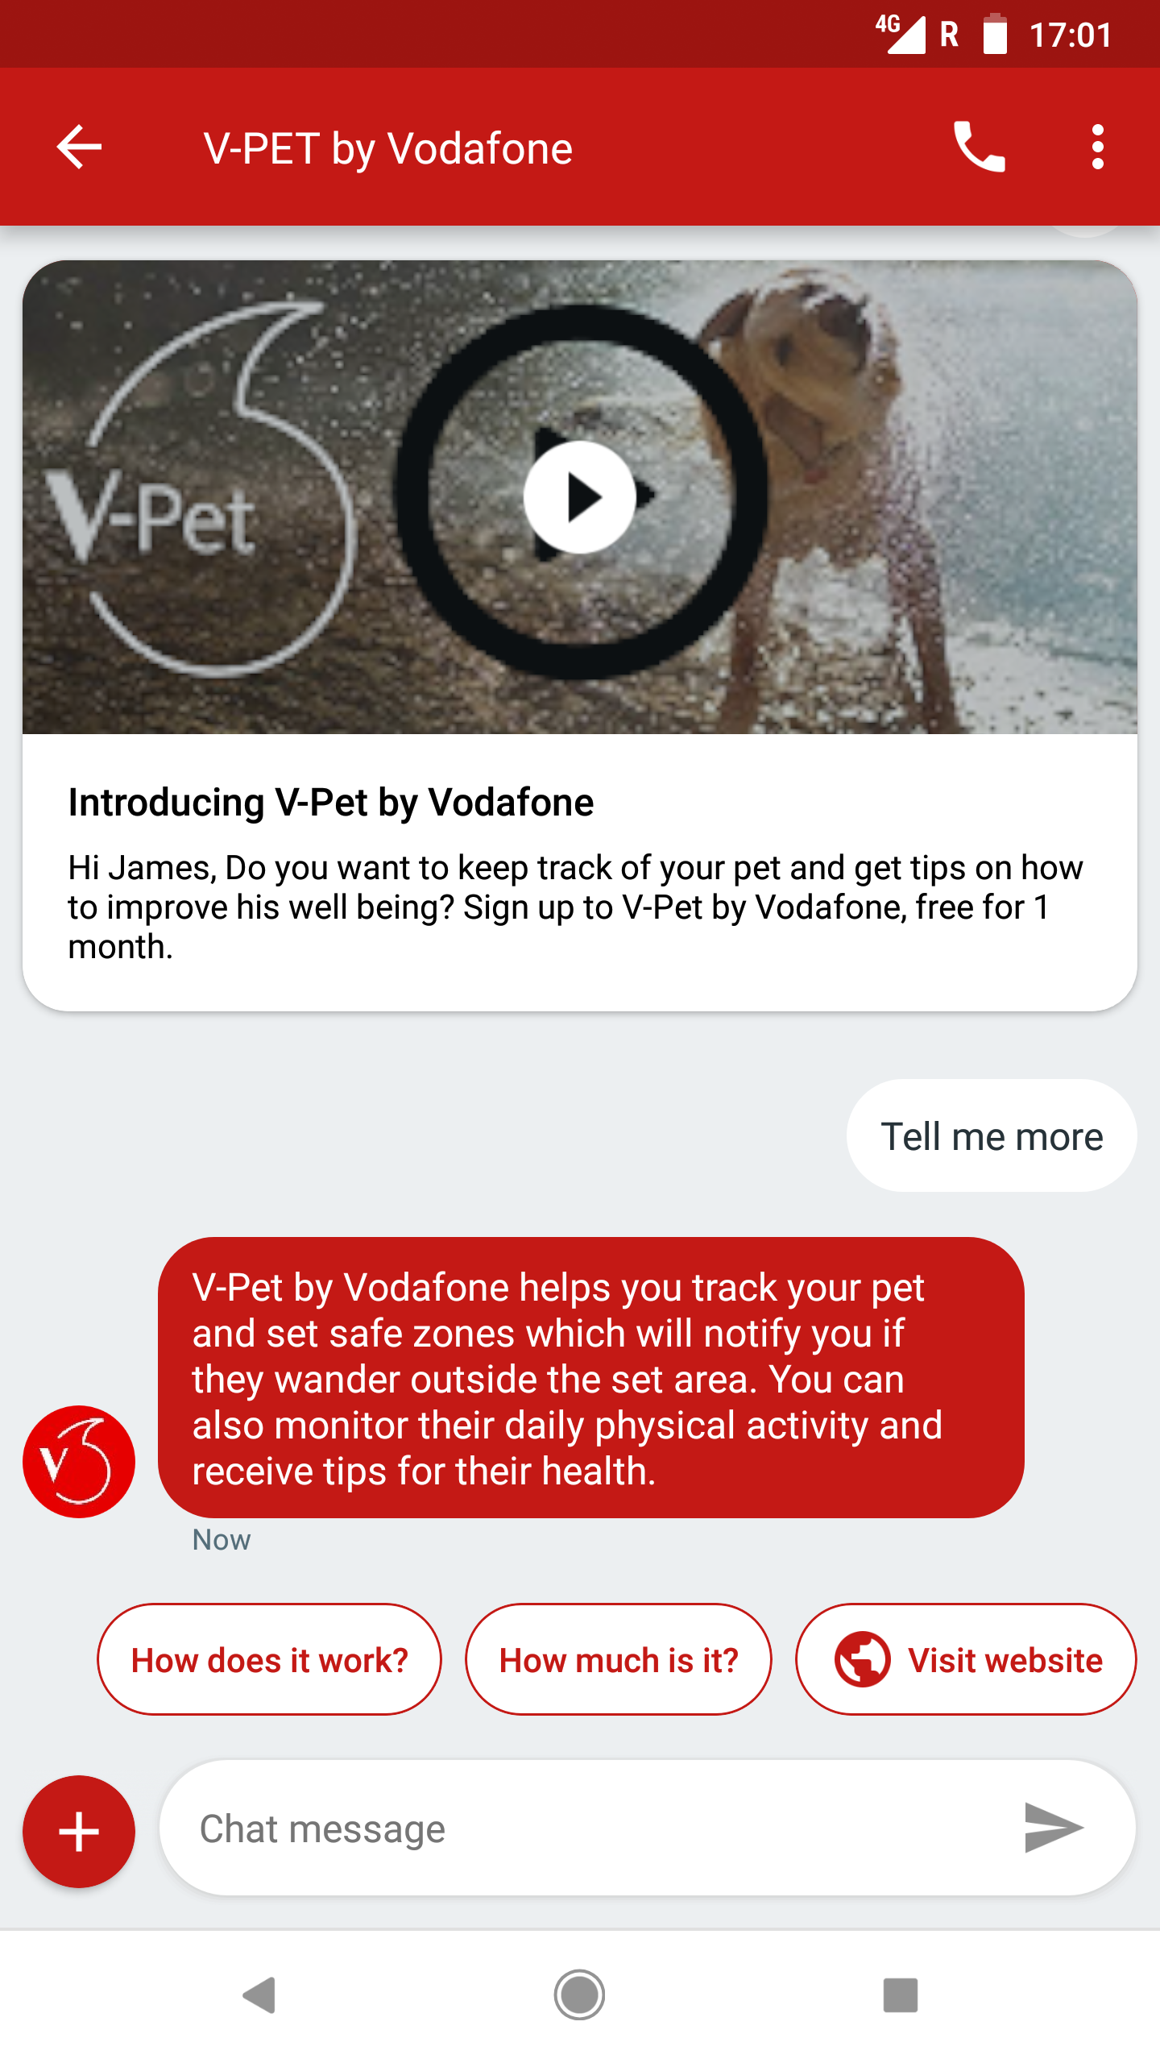


Live campaigns and trials on the way
Vodafone CVM campaigns
Brand campaigns
25+ times uplift in click-through rates compared to SMS A2P campaigns
High read-rates show end customer engagement and key insights to brands
Although the latest RCS experience is preferred, legacy RCS UX produced great results

Slide 7




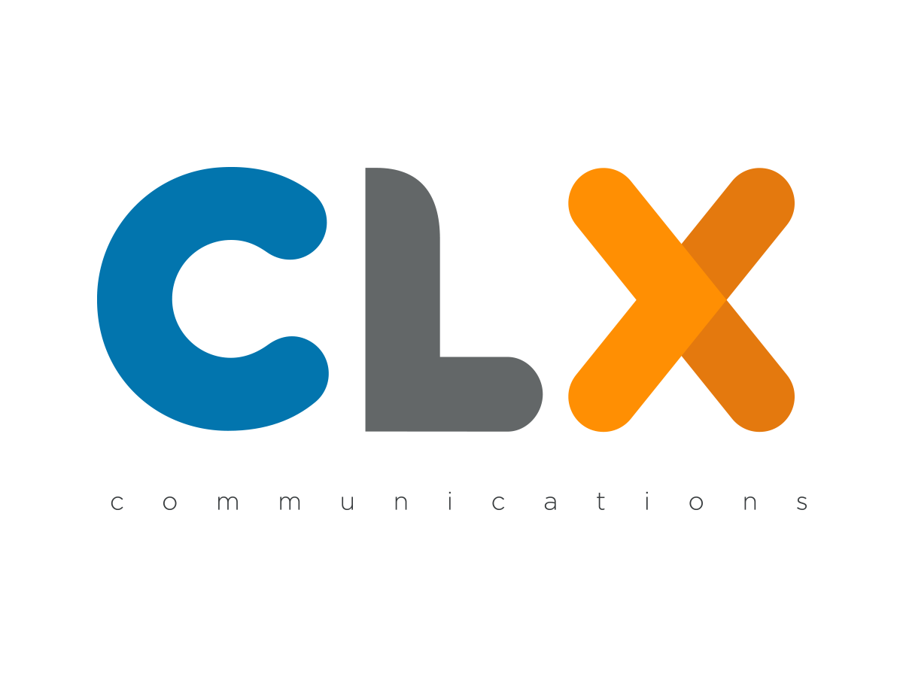
What’s next?
Progress further commercial campaigns combining RCS A2P legacy and optimised experience, leveraging the existing and increased reach
Explore & experiment with different commercial models (per message, session, value recognition, P2A/search)
Work in partnership to realise the full potential of the RCS ecosystem:
  A2P global reach
  Federated bot search and enhanced brand verification
  Fast-track feedback into GSMA RCS specifications

Slide 8
Thank you

